Slide 1
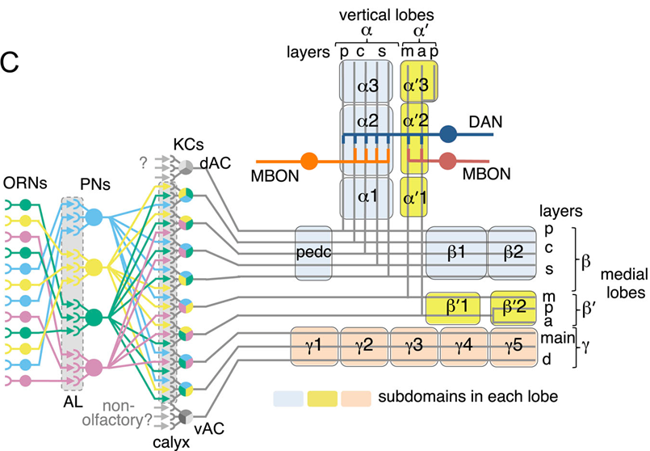

Slide 2
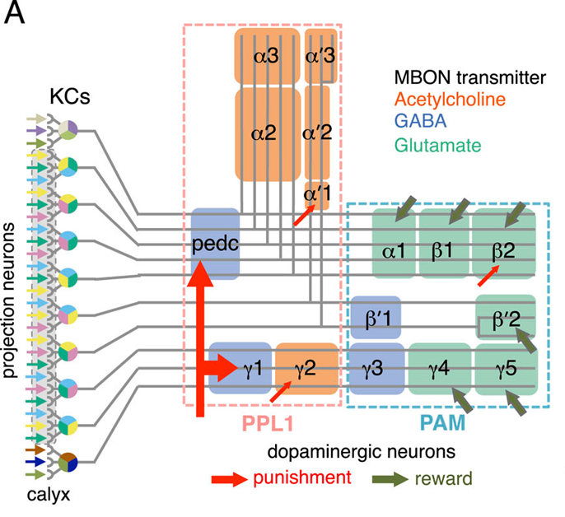

Slide 3
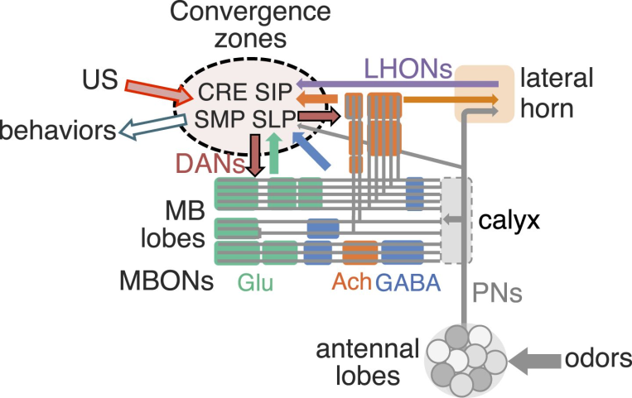
Figure 21.Schematic of the proposed convergence zone.MB lobes consist of three groups of compartments based on the putative transmitter of MBONs (glutamate, GABA, and acetylcholine, shown color-coded).
These compartments are interconnected inside the lobes and the MBONs send converging outputs (color-coded arrows) to small subregions within five neuropils: the lateral horn (LH), CRE, SMP, SIP, and SLP. The dendrites of DANs are also confined mostly in the convergence zones within the CRE, SMP, SIP, and SLP. These neuropils, therefore, must receive information encoding the unconditioned stimuli (US), such as sugar and shock, which recruit DANs for memory formation.
In the simplest model, these same sensory inputs would activate not just the DANs but also other output neurons of these neuropils that elicit appropriate unconditioned behaviors. MBON, conveying the learned valence of stimuli, might then terminate onto these same output neurons. A subset of projection neurons from the antennal lobe and LH output neurons (LHONs) also converge with MBONs in these zones (see accompanying paper Aso et al., 2014). In this way, learned and innate responses could use a common set of downstream circuits, originating in the LH, CRE, SMP, SIP, and SLP, to drive behavior.

Slide 4
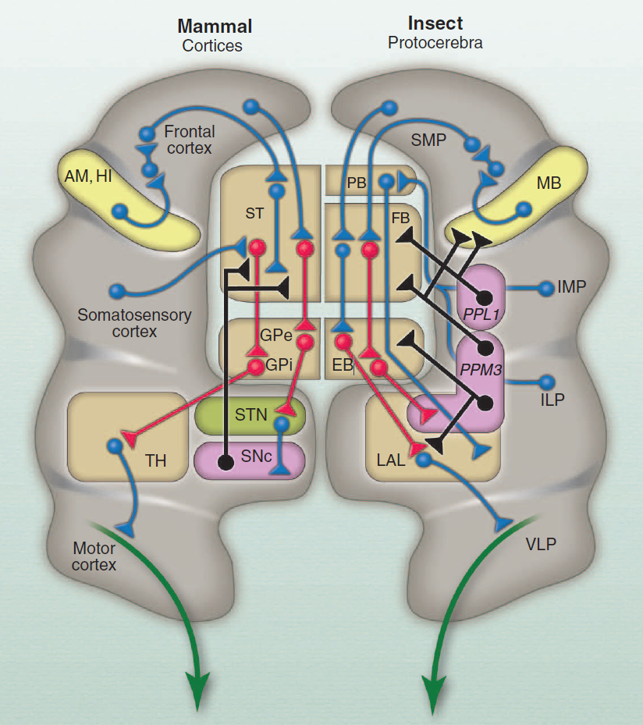

Slide 5
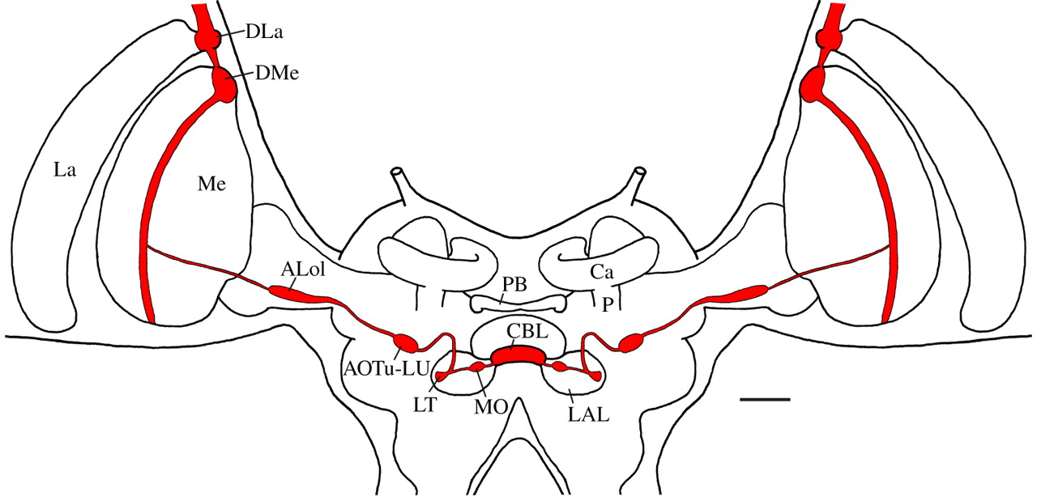
Figure 3.Polarization–vision pathway to the central complex in the brain of the locust, as revealed through tracer injections into the dorsal rim area of the eye, into the dorsal rim of the medulla (DMe), into the anterior optic tubercle (AOTu) and through dye injection into single neurons of the central body.
Central processing stages for polarized light include the dorsal rim of the lamina and medulla (DLa and DMe), layer 1 of the anterior lobe of the lobula (ALo1), the lower unit of the AOTu (AOTu-LU), the median olive (MO) and lateral triangle (LT) of the lateral accessory lobe (LAL), and the lower division of the central body (CBL). Ca and P, calyx and pedunculus of the mushroom body; La, lamina; Me, medulla; PB, protocerebral bridge. Scale bar, 200 µm. Adapted from Träger et al. [38].

Slide 6
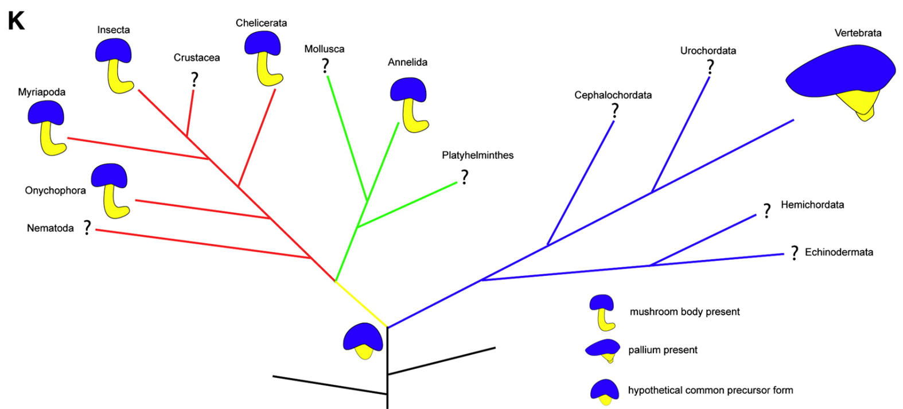

Slide 7
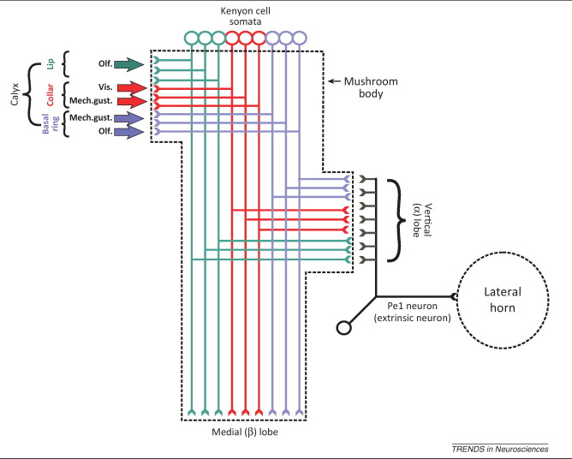
Figure 4.
Scheme of a mushroom body (delineated by dashed straight lines) showing segregated multisensory input at the level of the calyx and integrated multimodal output at the level of the vertical (α) lobe. The somata of the Kenyon cells (KCs), which integrate the mushroom body, are located in the calyx bowl.
The dendrites of the KCs form the calyx, which is subdivided into three main regions: the lip, receiving olfactory afferences; the collar, receiving mainly visual but also mechanosensory and gustatory afferences; and the basal ring, receiving olfactory, mechanosensory, and gustatory afferences 77, 79 and 80. The axons of the KCs subdivide and form the vertical (α) and medial (β) lobes.
An extrinsic, multimodal pedunculus neuron, the Pe1 neuron 81, 97 and 98, is shown, whose dendrites arborize across the vertical lobe; its axon projects to the lateral horn (delineated by a dashed circle).

Slide 8
Fig. 2 Proposed correspondences of neural organization of the mammalian basal ganglia and insect central complex.
Corresponding regions of the basal ganglia (left) and insect central complex (right) and their associated regions are aligned, as are their relevant connections. Inhibitory pathways are shown in red, dopaminergic pathways in black, and other pathways (excitatory or modulatory) in blue.
The striatum (ST = caudate nucleus + putamen) corresponds to the fan-shaped body and protocerebral bridge (FB+PB); the external and internal globus pallidus (GPe, GPi) correspond to the ellipsoid body (EB).
There is no center in the insect corresponding to the vertebrate subthalamic nucleus (STN) as an intermediate station between the GP and the dopaminergic substantia nigra pars compacta (SNc).
Inputs to the striatum derive from sensory and association cortices (gray), from the hippocampus and amygdala (HI, AM; yellow), and from the limbic system (not shown) via the frontal cortex (17, 20).
In insects, inputs to the FB and PB derive from sensory intermediate and inferior lateral protocerebra (IMP, ILP) (21, 22, 25–27, 30) and associative superior medial protocerebrum (SMP), which receives learned visual cues and outputs from the mushroom bodies (MB) (29, 74), the latter center corresponding to the mammalian hippocampus (5, 59).
The PB, FB, and EB are connected by through-going presumably excitatory columnar neurons, many of which also extend to the lateral accessory lobes (LAL) (21, 24, 25). GABAergic outputs from the insect EB supply the LAL and its associated neuropils (30, 32). The LAL is here equated to the vertebrate thalamus (TH) supplied from the globus pallidus (2). Both the TH and LAL supply motor centers [mammal: motor cortices (2); insect: inferior and ventrolateral protocerebra (ILP, VLP) (75)].
In insects, dopamine pathways extending from PPM3 and PPL1 domains to the FB and EB (37–43) correspond to dopamine innervation of the striatum from the SNc (35, 76). Descending pathways [vertebrate: from motor cortices to spinal cord; insect: from the ILP, VLP to the ventral cord and ganglia (77)] are shown in green.

Slide 9
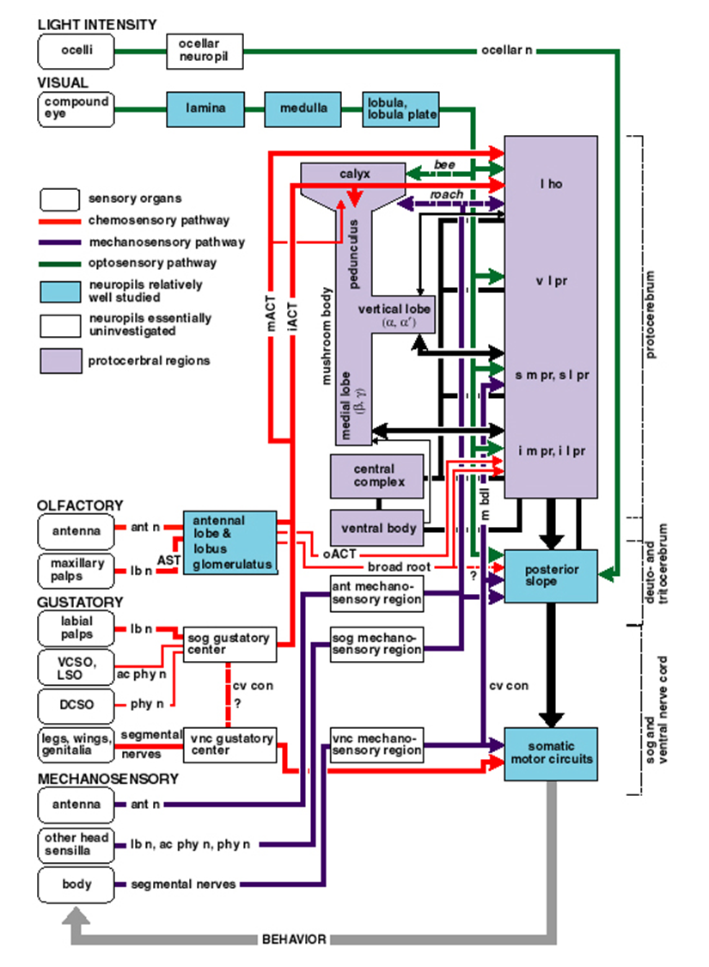

Slide 10
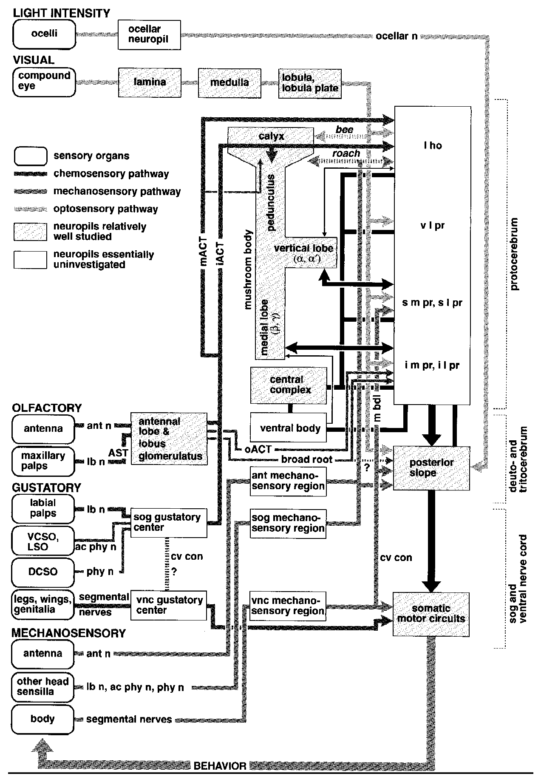
Figure 9
Relationships between the mushroom body and other parts of the nervous system.
(Round-cornered boxes) Sensory organs grouped according to modality.
(Shaded boxes) Neuropil regions relatively well investigated. (White boxes) Regions essentially uninvestigated. (Thick shaded lines)
Major tracts connecting neuropil regions. (Arrows) Supposed direction of information (omitted where evidence for polarity is lacking).
Information about ambient light intensity is received by the ocelli, preprocessed in the ocellar neuropil and sent to the caudal part of the deutocerebrum (posterior slope) via the ocellar nerve (ocellar n).
Visual information is received by the compound eyes and processed in nested retinotopic optic lobe neuropils (lamina, medulla, and lobula/lobula plate) before entering the central brain.
The ventro-lateral protocerebrum (v l pr) receives visual signals almost exclusively, and thus can be considered to contain the primary optic foci.
Other areas [e.g., lateral horn (l ho); superior lateral protocerebrum (s l pr); inferior lateral protocerebrum (i l pr)] are also supplied by the optic lobes, but they also receive inputs from other sensory neuropils.

Slide 11
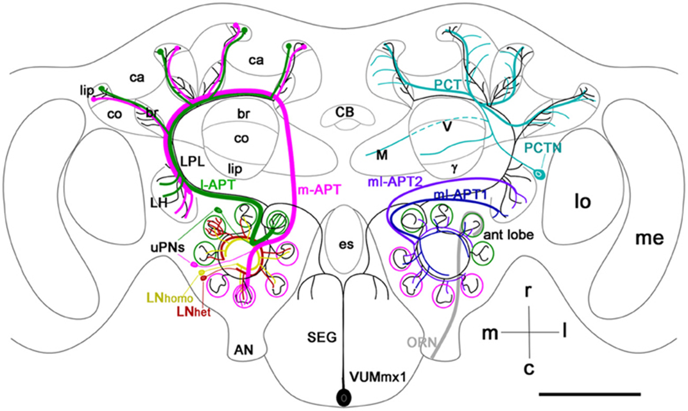

Slide 12
Figure 1. Schematic view of the main olfactory pathways in the honey bee brain (based on Fonta et al., 1993; Abel et al., 2001; Strausfeld, 2002; Sinakevitch et al., 2005, 2011; Kelber et al., 2006; Kirschner et al., 2006; Schröter et al., 2007;Girardin et al., 2013). Olfactory Receptor Neuron (ORN) axons from the antenna enter through the antennal nerve (AN) into the antennal lobe (ant lobe) and converge onto the outer cortex of glomeruli. Each glomerulus is innervated by processes of several types of neurons.
Uniglomerular projection neurons (uPNs magenta and green) have dendritic branches in a single glomerulus and send axons to higher-order brain centers such as the MB calyces (ca), lateral protocerbral lobe (LPL), and lateral horn (LH). There are two uniglomerular antenno-protocerebral tracts, the l-APT (green) and m-APT (magenta), which reflect the segregation of glomeruli into rostral (l-APT) and caudal (m-APT) hemispherical clusters.
Kenyon cells (not shown in the figure) are the intrinsic cells that make up the MB. Kenyon cell dendrites form pairs of calyces (ca) with specific zones that receive different types of inputs, the lip, collar (co), and basal ring (br). The lip and br are innervated by uPN axons. The Kenyon cell axons project ventrally and split to form medal (M), vertical (V), and γ lobes, which are the main output regions of the MB. Protocerebral tract neurons (PCTN) receive inputs in the lobes and provide GABAergic feedback to the calyces.
Multiglomerular PNs project axons via the medio-lateral protocerebral tracts (ml-APT 1,2) to the LPL and LH. At least two types of local interneurons (LN) interconnect glomeruli within the AL, homogeneous LNhomo (yellow), and heterogeneous LNhet (red). Ventral unpaired median neurons (VUM) have cell bodies in the maxillary (VUMmx1 is shown) and mandibullar neuromeres of the subesophageal (SEG) ganglion and connect gustatory processing in the SEG to all antennal lobe glomeruli, the LPL, LH, and MB calyces.
CB, central body; M, medial lobe; V, vertical lobe; γ, gamma lobe; lo, lobula; me, medulla; m, median; l, lateral; r, rostral; c, caudal. Cell types in each side of the brain are bilaterally symmetric, but for clarity different cells are shown in each half. Scale bar: 250 μm.

Slide 13
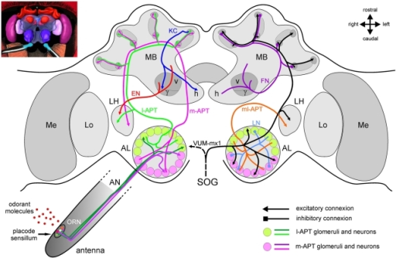
Figure 2: The honeybee brain and the olfactory pathway.
For clarity, different neuron types have been presented separately in the two brain hemispheres. On the left, major excitatory pathways involved in the transmission of olfactory information in the brain are shown. On the right, mostly inhibitory connections and modulatory neurons are presented. The antennal lobe, first-order olfactory neuropil, receives input from ~60,000 olfactory receptor neurons (ORNs) which detect odorants within placode sensilla on the antenna. Within the AL’s anatomical and functional units, the 165 glomeruli, ORNs contact ~4000 inhibitory local neurons (LNs) which carry out local computations, and ~800 projection neurons which further convey processed information via different tracts.
The lateral antenno-cerebralis tract (l-APT) projects first to the lateral horn (LH) and then to the mushroom body (MB) calyces (lips and basal ring), while the medial tract (m-APT) projects to the same structures, but in the reverse order. Both tracts are uniglomerular, each neuron taking information within a single glomerulus. They form two parallel, mostly independent olfactory subsystems (in green and in magenta), from the periphery until higher-order centers, where they project in non-overlapping regions. Multiglomerular projection neurons form a medio-lateral tract (ml-APT) which conveys information directly to the medial protocerebrum and to the LH.
The dendrites of the Kenyon cells (KCs), the mushroom bodies’ 170,000 intrinsic neurons, form the calyces, while their axons form the pedunculus. The output regions of the MB are the vertical and horizontal lobes, formed by two collaterals of each KC axon. Within the MBs, feedback neurons (FN) project from the pedunculus and lobes back to the calyces, providing inhibitory feedback to the MB input regions. Extrinsic neurons (ENs) take information from the pedunculus and the lobes and project to different parts of the protocerebrum and most conspicuously to the LH. It is thought that descending neurons from these areas are then involved in the control of olfactory behavior. The figure also presents a single identified octopaminergic neuron, VUM-mx1, which was shown to represent reinforcement during appetitive conditioning. This neuron projects from the suboesophageal ganglion (SOG), where it gets gustatory input from sucrose receptors, to the brain and converges with the olfactory pathway in three areas, the AL, the MB calyces, and the LH.

Slide 14


