Slide 1
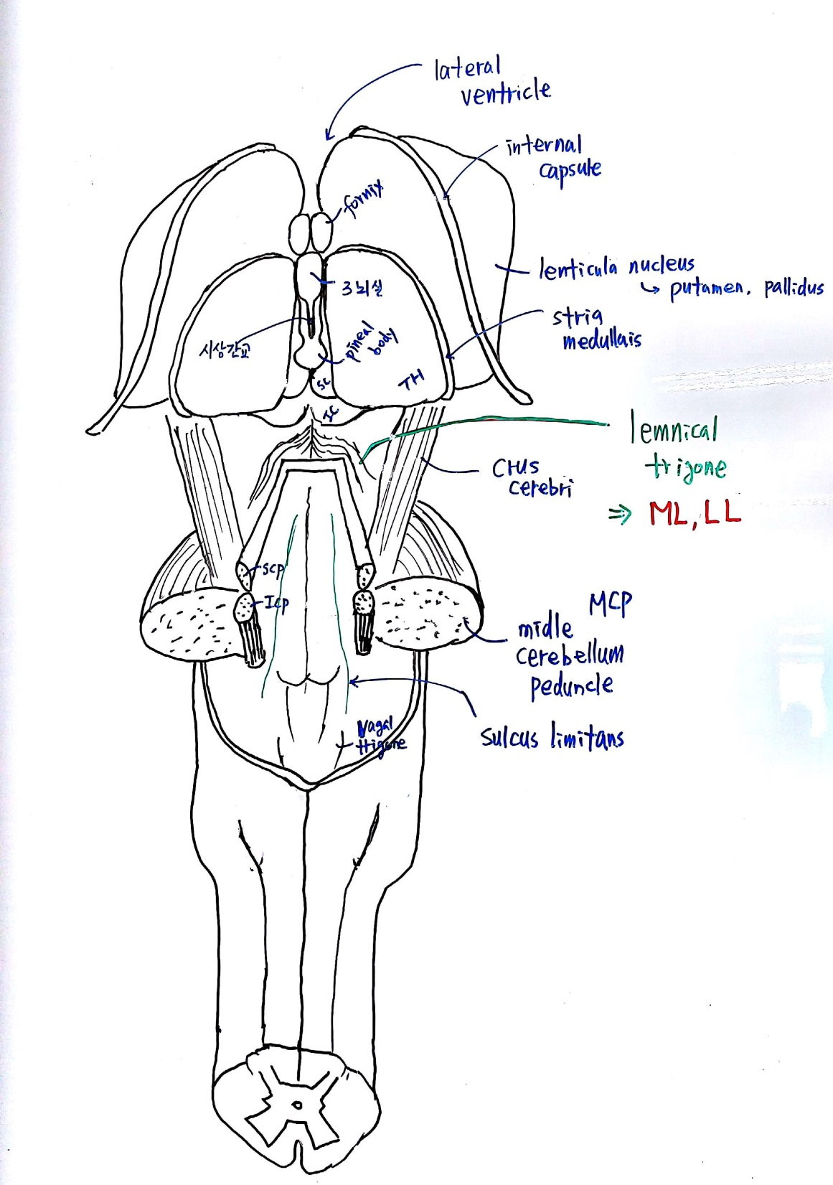
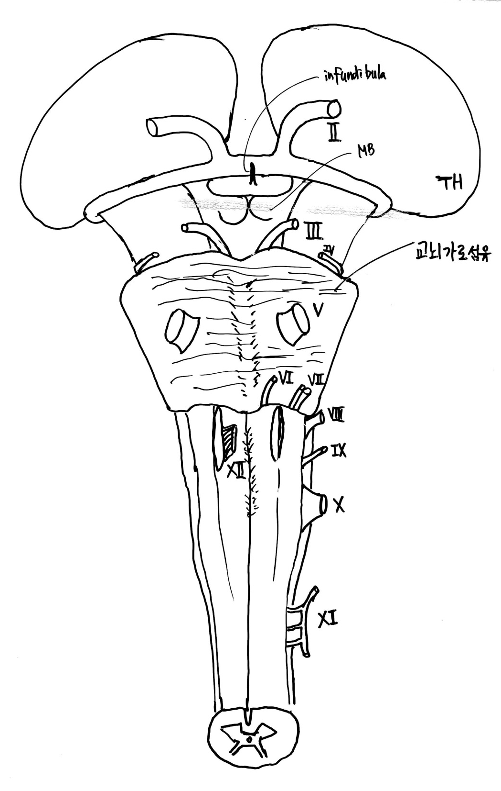
#2. brainstem
뒷면
#3. brainstem
앞면

Slide 2


