Slide 1
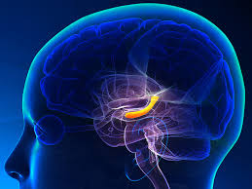
Hippocampus
제8회 특뇌5강(2016.10.16)

Slide 2
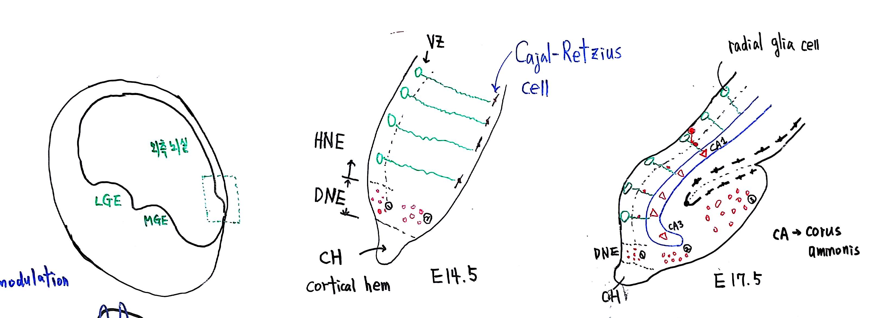
▶MGE - medial ganglion eminence
▶LGE - lateral ganglion eminence
▶HNE - hippocampal neuro epithelium
▶DNE - dantate neuro epithelium
▶VZ – ventrical zone

Slide 3
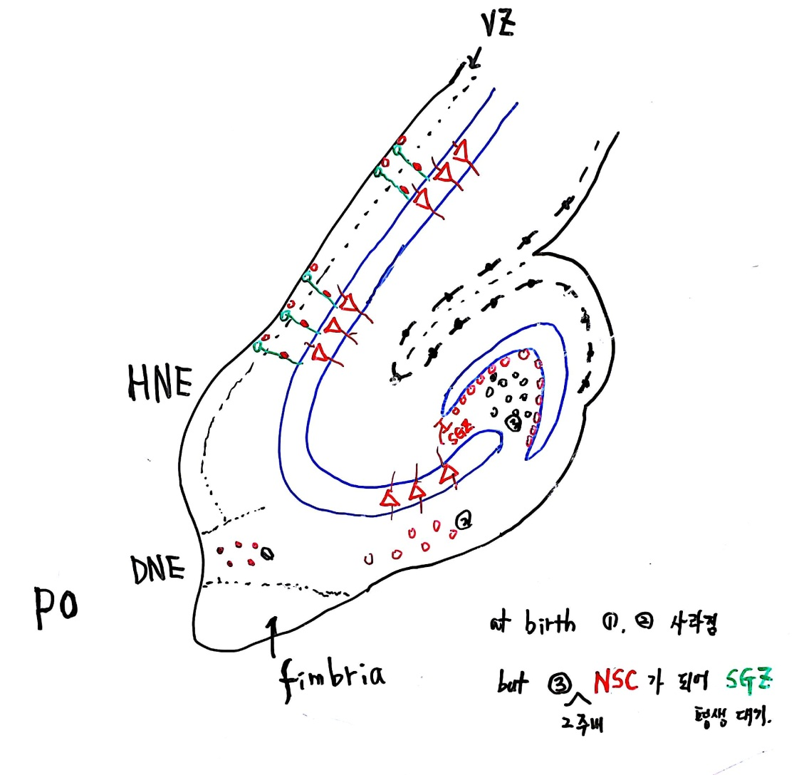
▶SGZ
- subgranular zone
▶NSC
- neural stem cell 신경줄기세포
▶PO
- post of birth

Slide 4
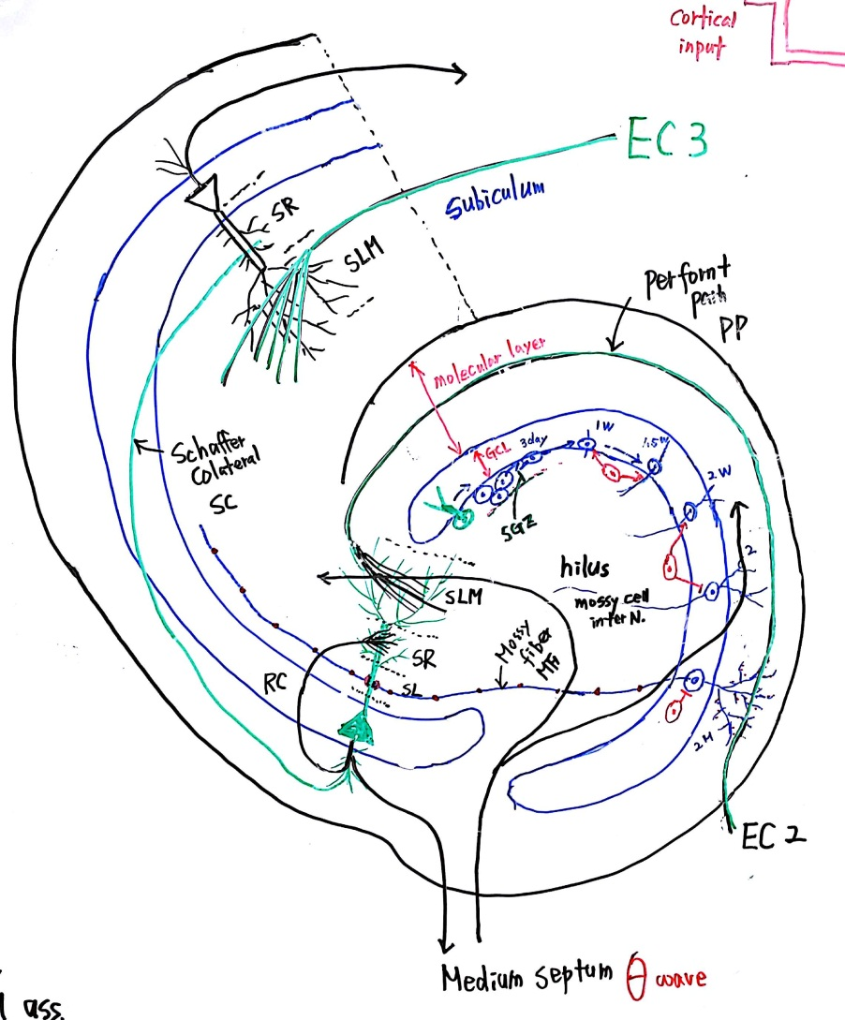

Slide 5
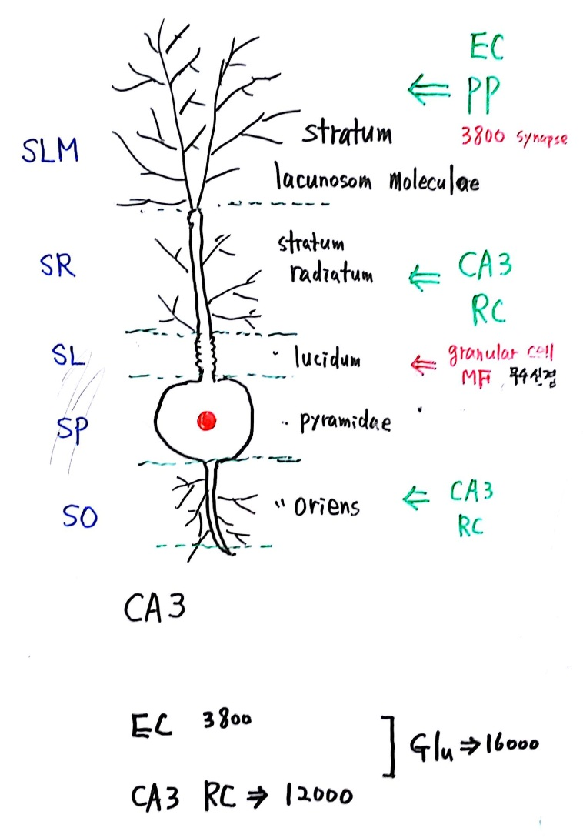

Slide 6
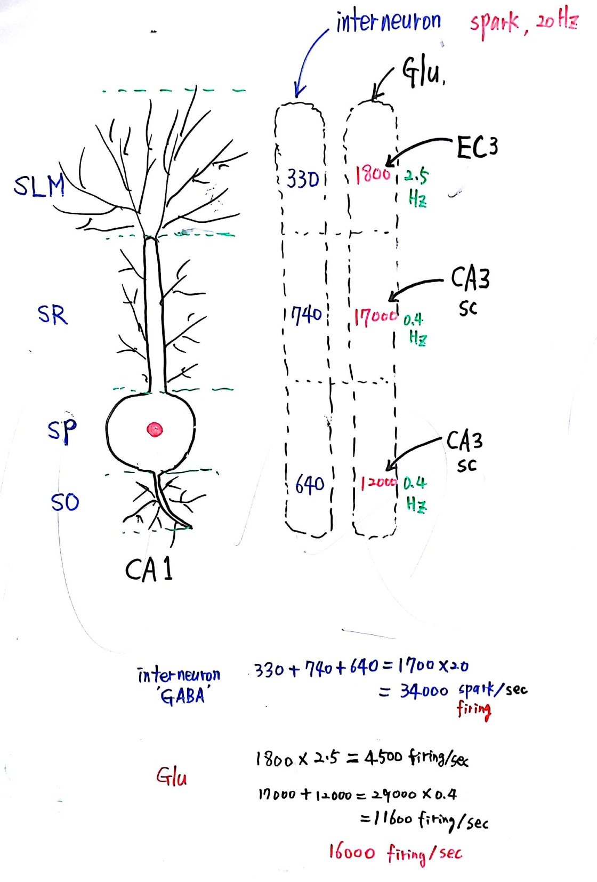

Slide 7
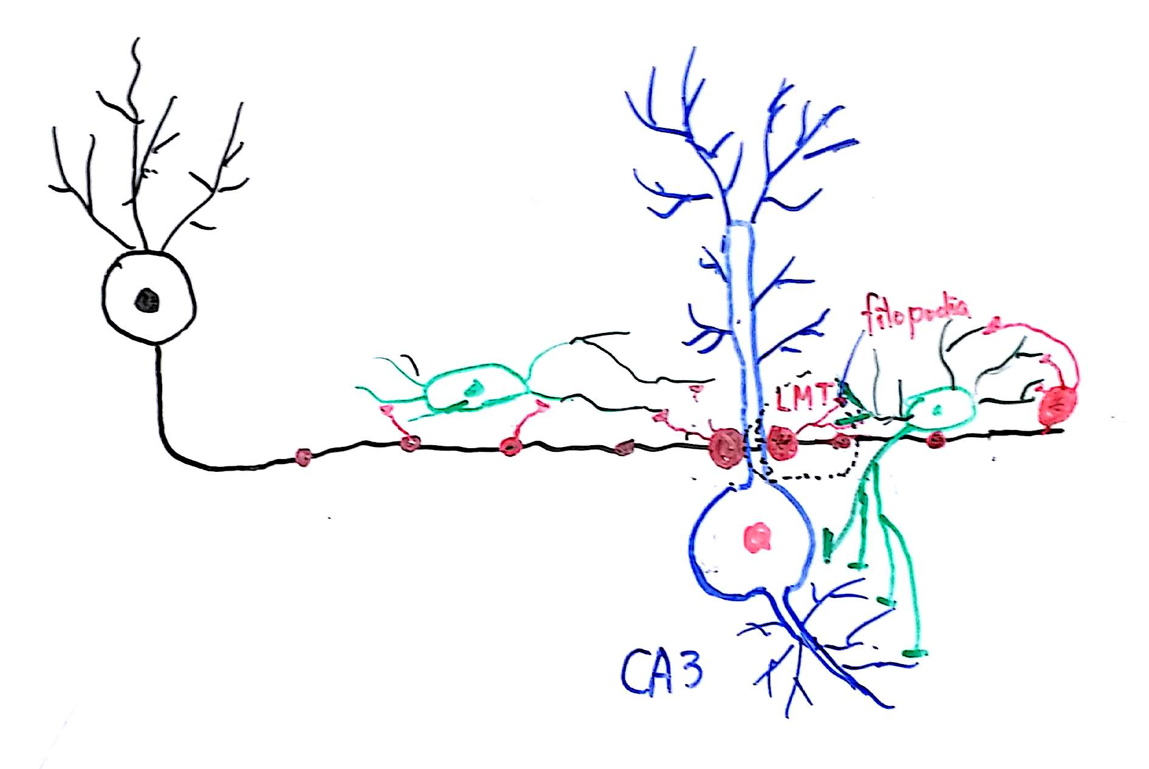
▶LMT – large mossy fiber terminal

Slide 8
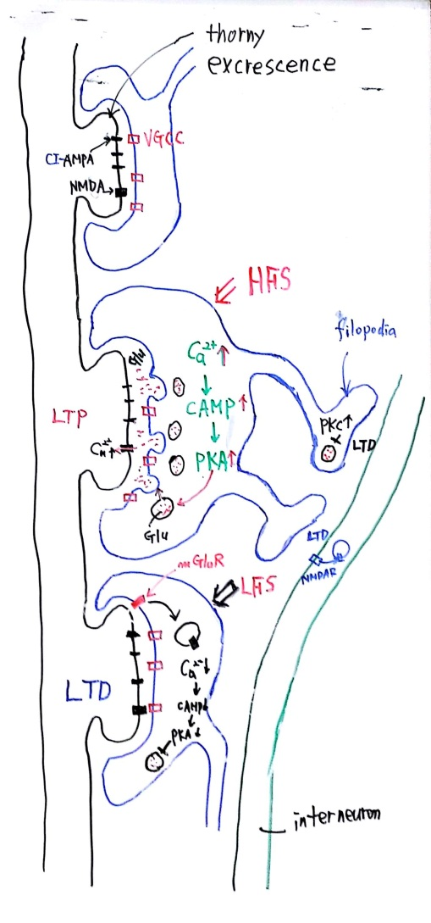
- HFS high-frequency eletrical stimulation
- LFS low-frequency eletrical stimulation
- LTP long-term potentiation
- LTD long-term depression
- PKA protein kinase A
- PKC protein kinase C
- Glu glutamate

Slide 9
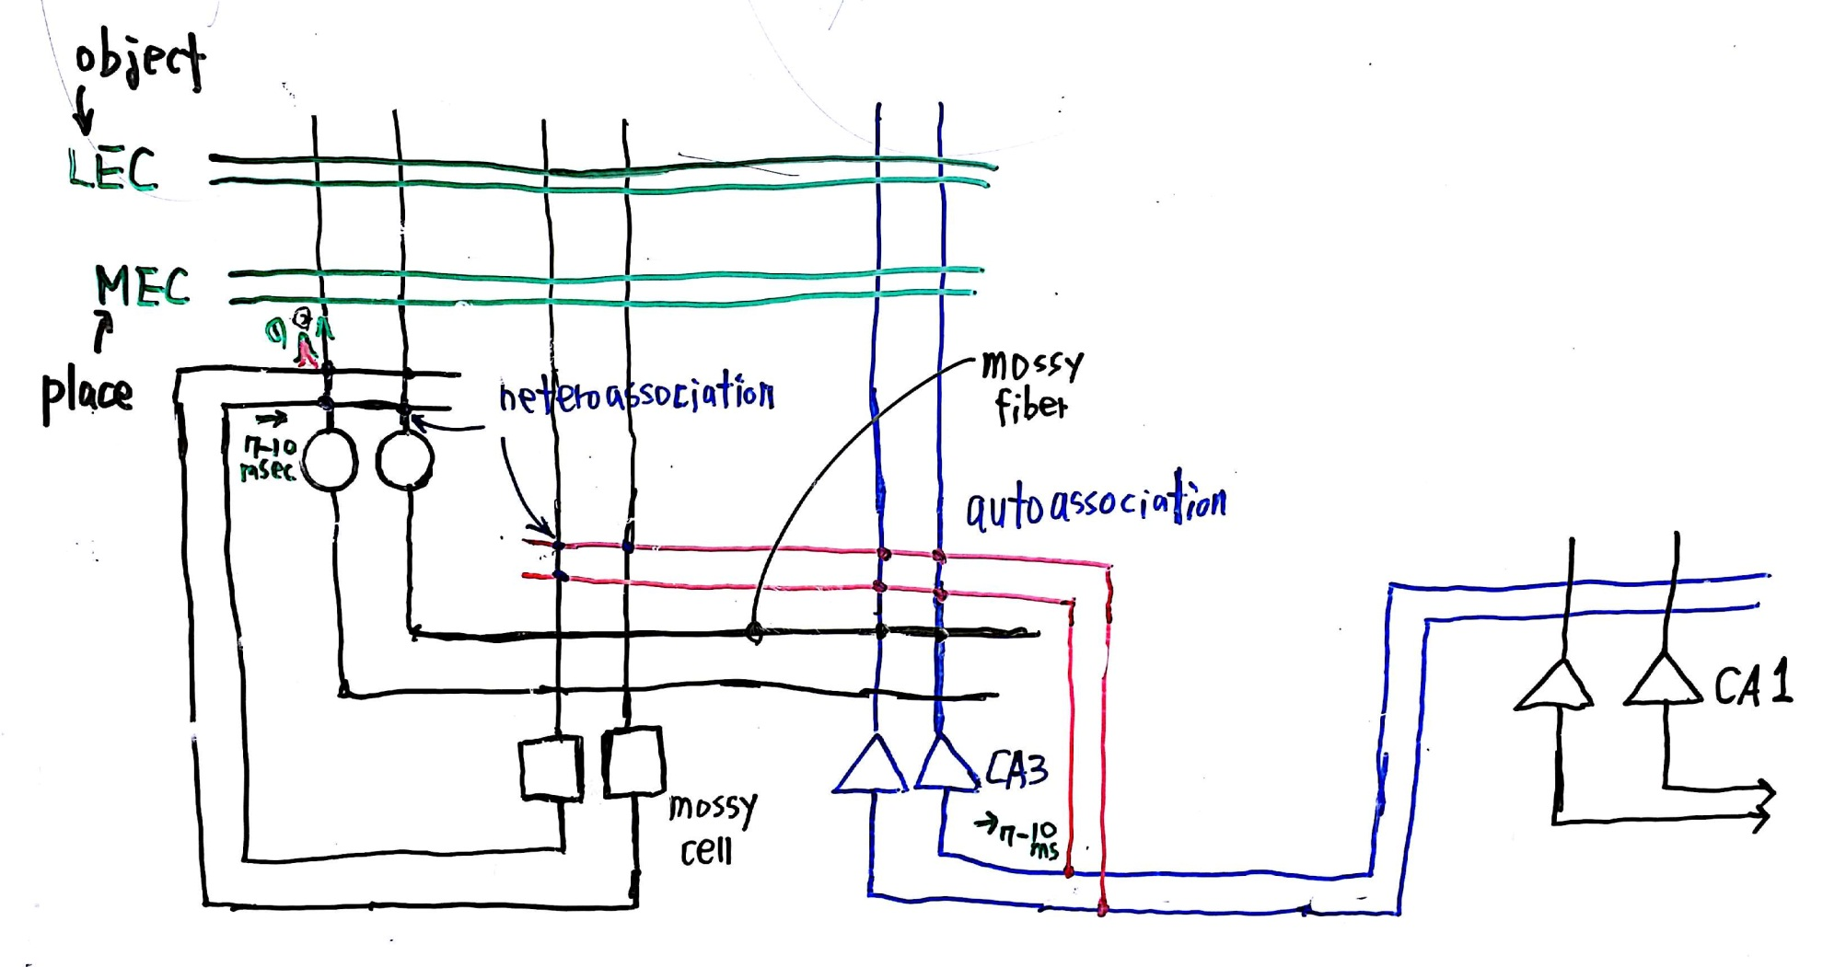
▶LEC lateral entorhinal cortex
▶MEC medial entorhinal cortex

Slide 10
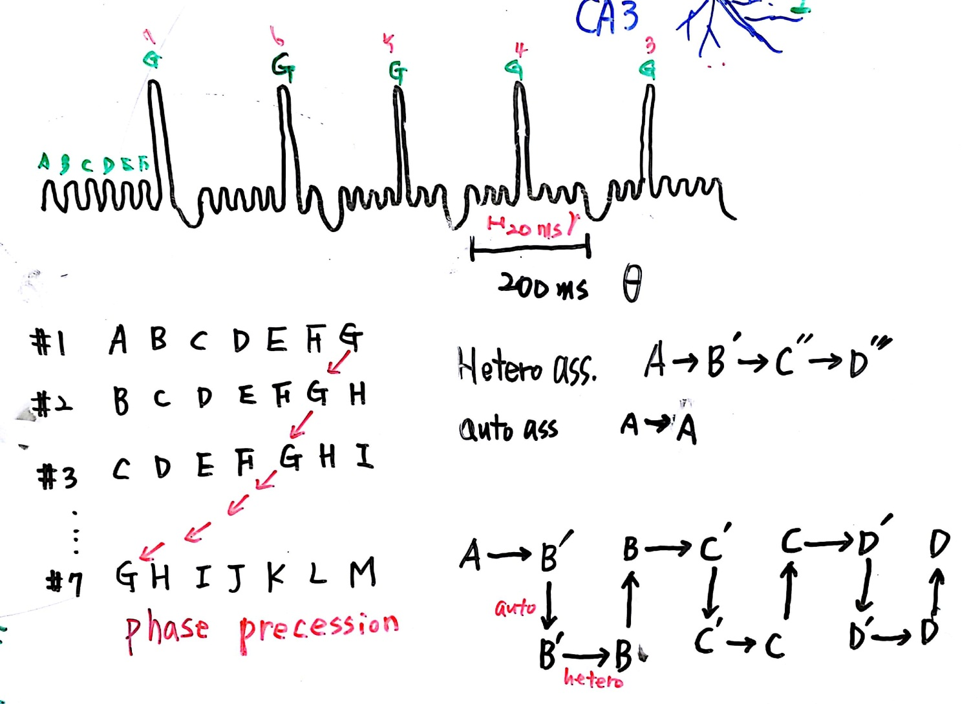

Slide 11
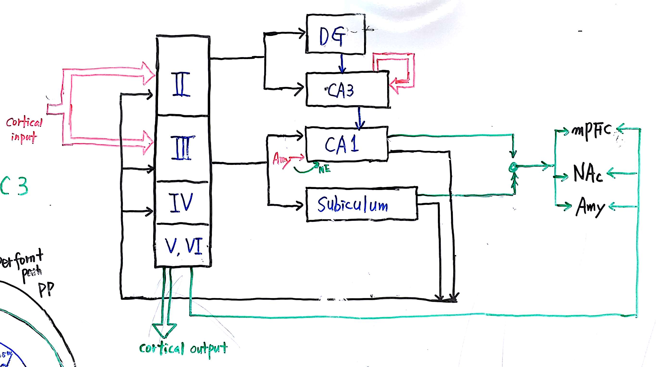

Slide 12
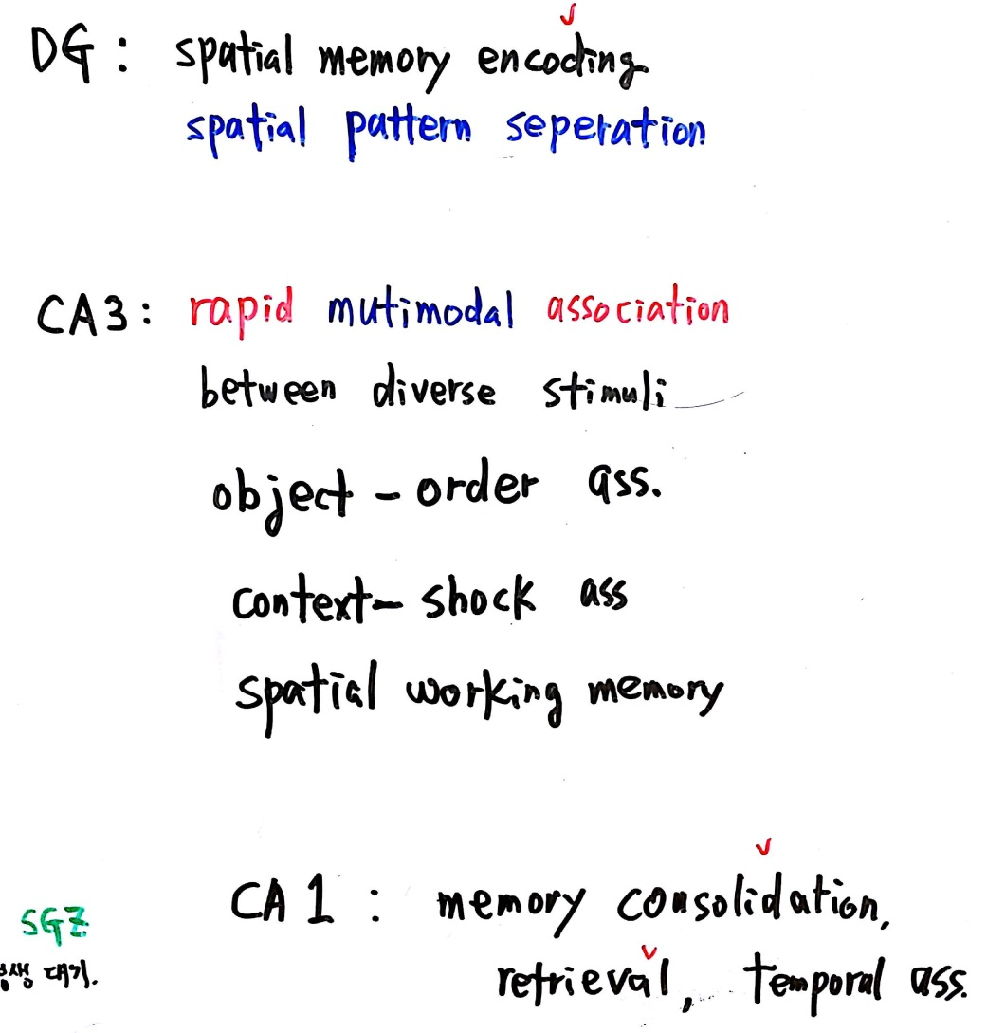

Slide 13
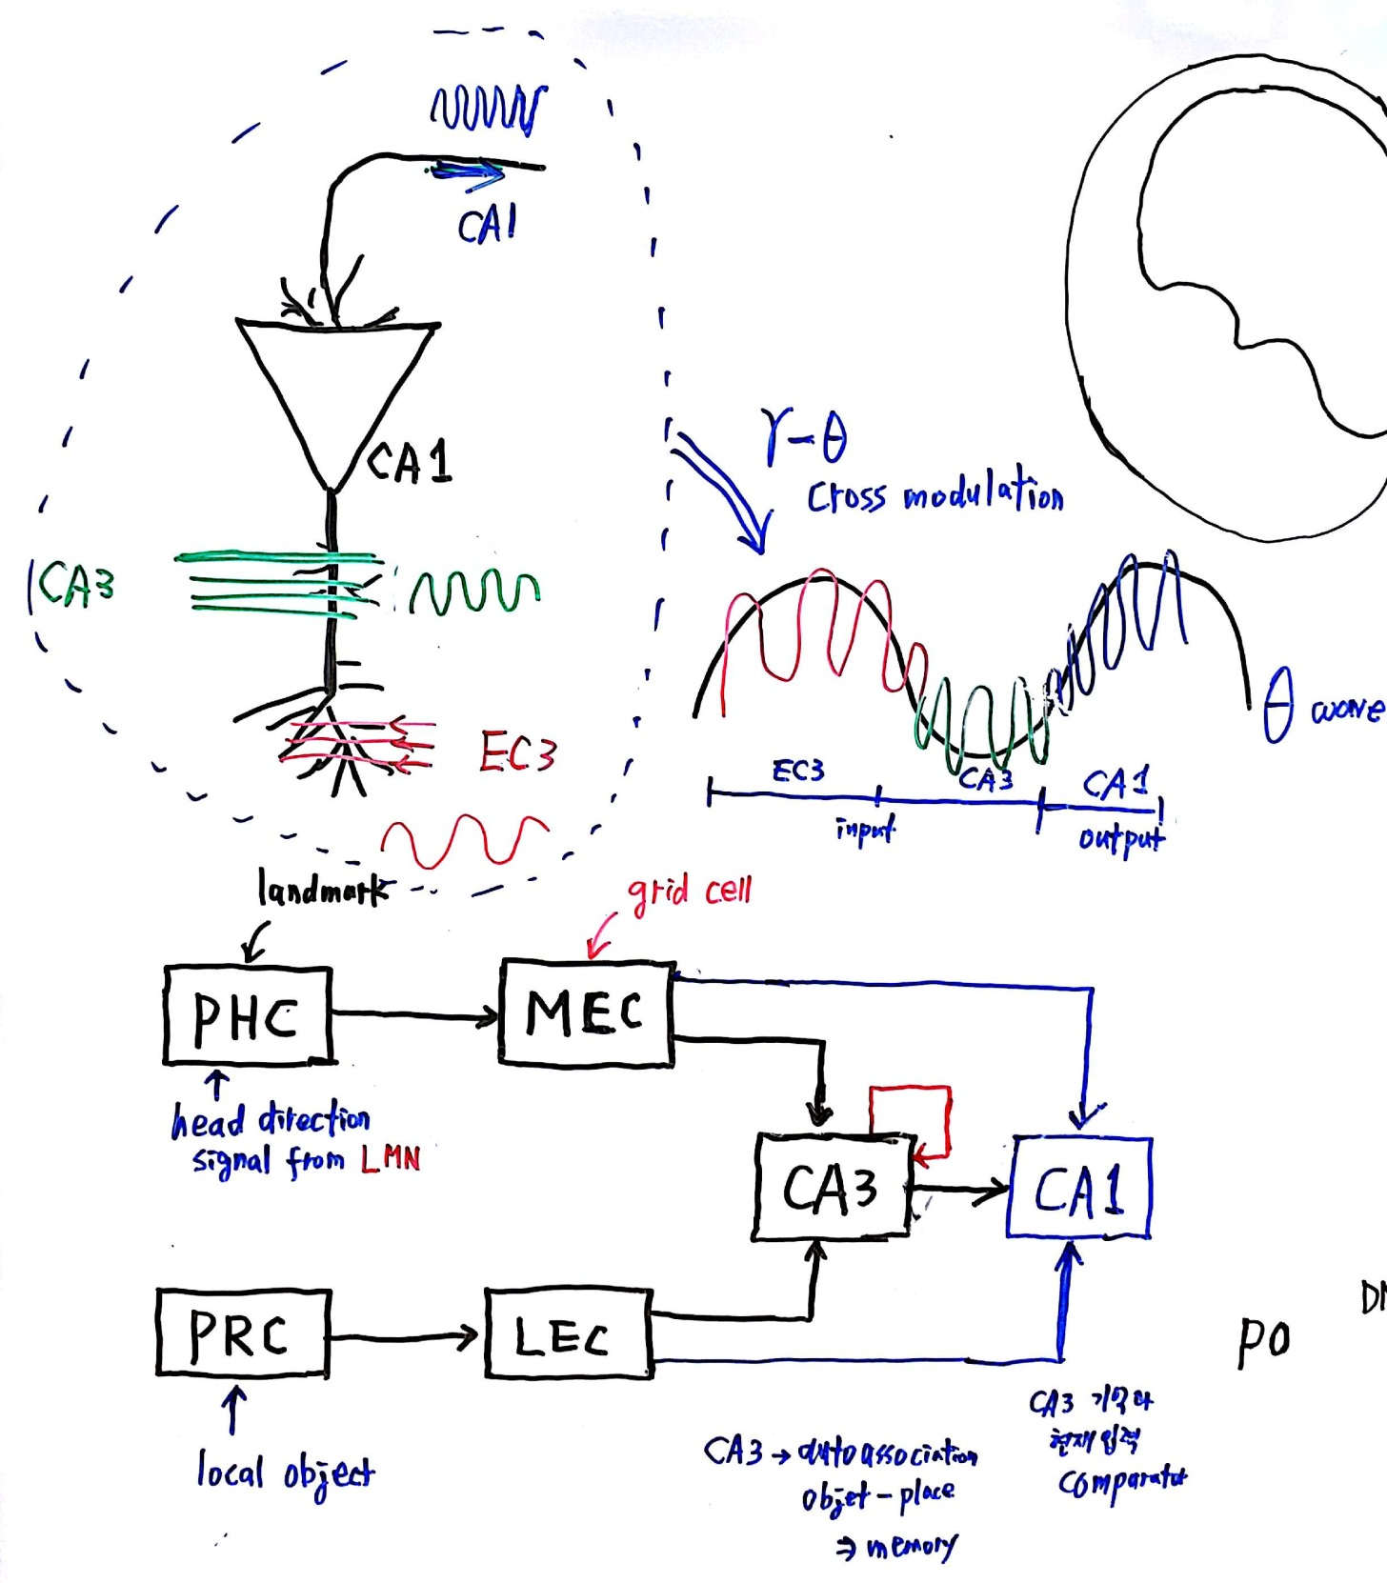
▶LMN
- lateral mammillary nucleus

Slide 14
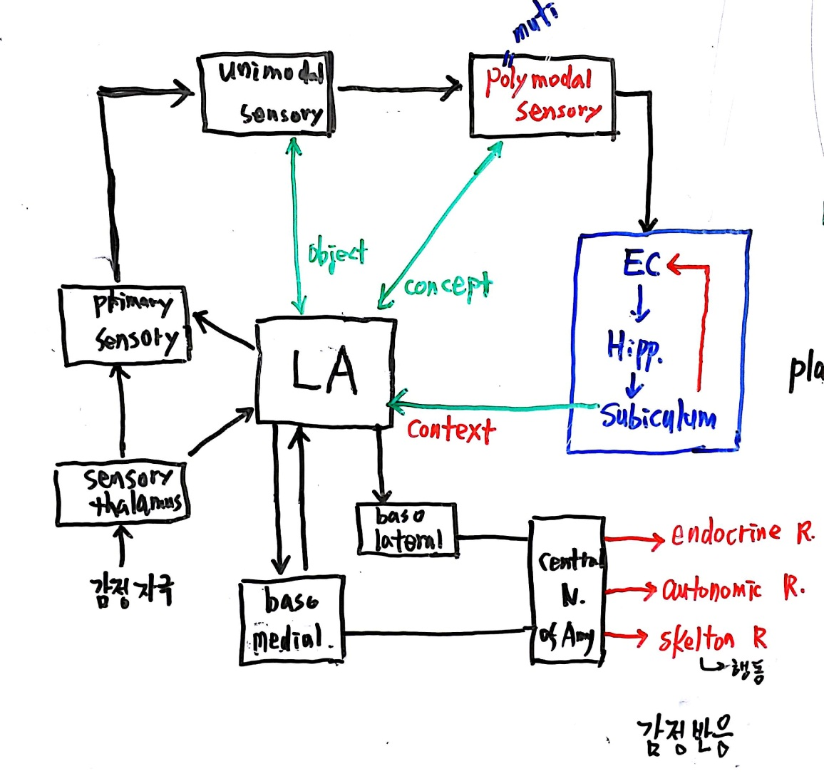
▶LA
- lateral amygdala

