Slide 1
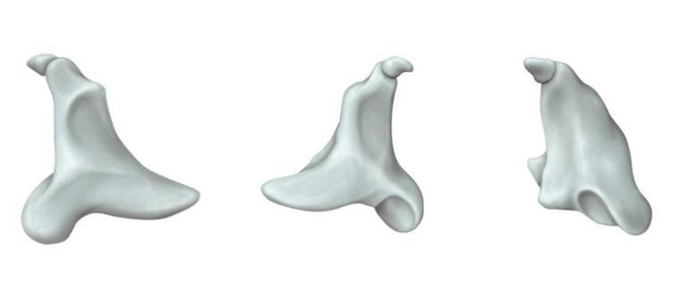
뇌와 언어
2016 제8회 특별한 뇌과학8강(11.20)

Slide 2
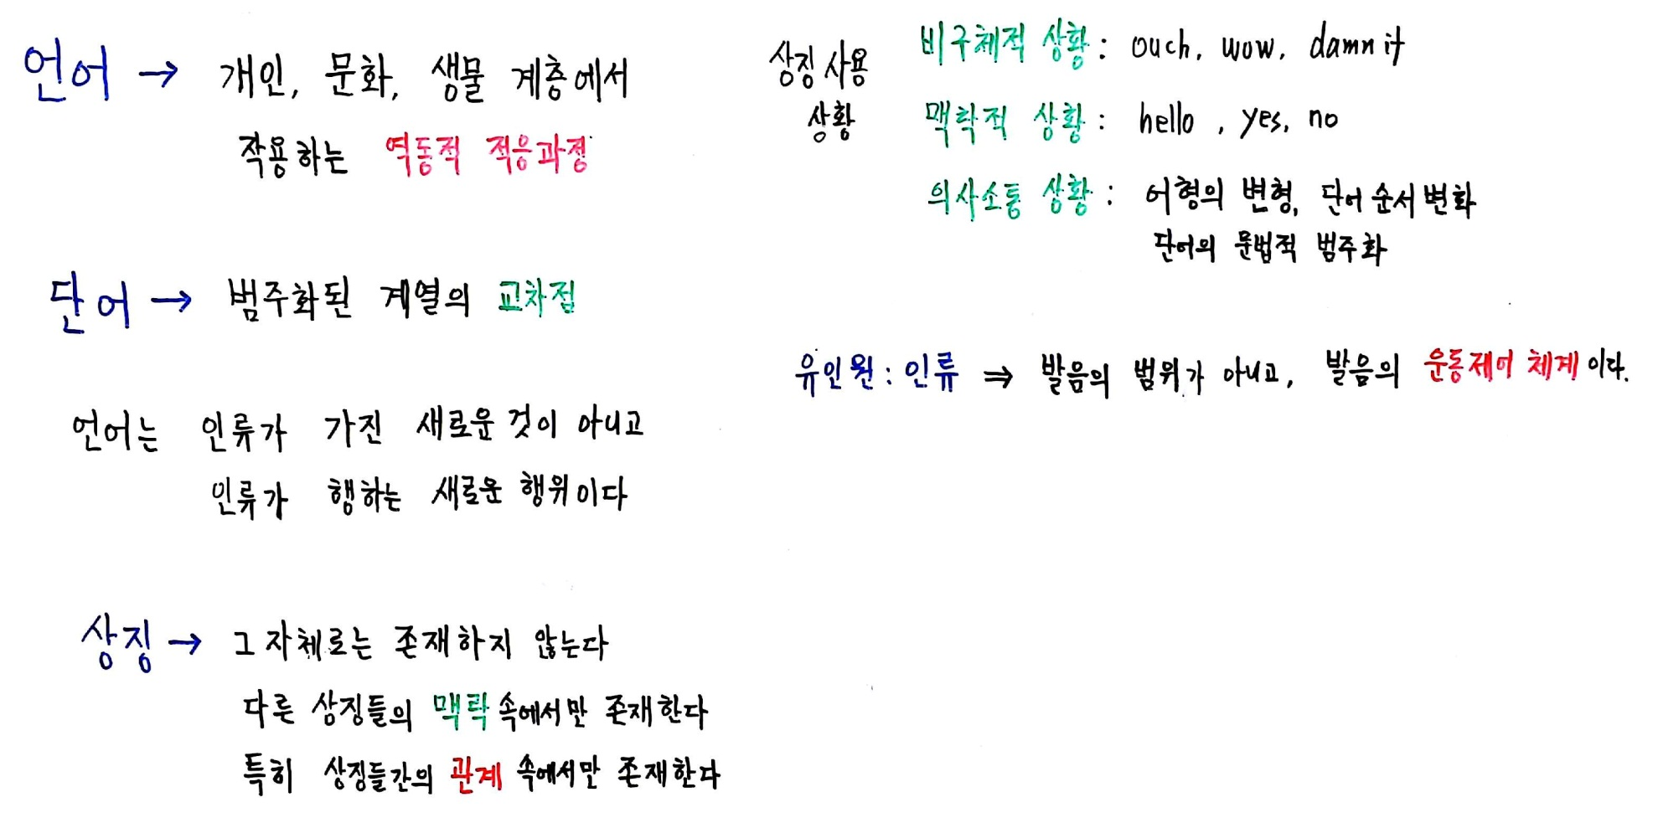

Slide 3
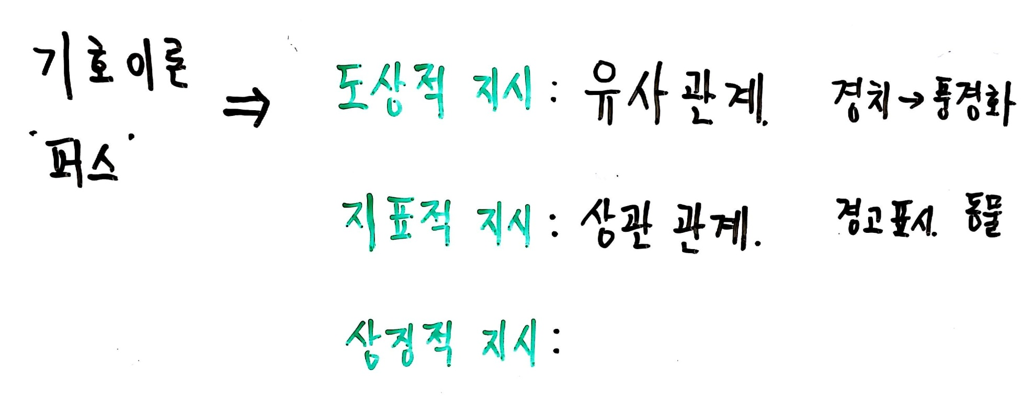

Slide 4
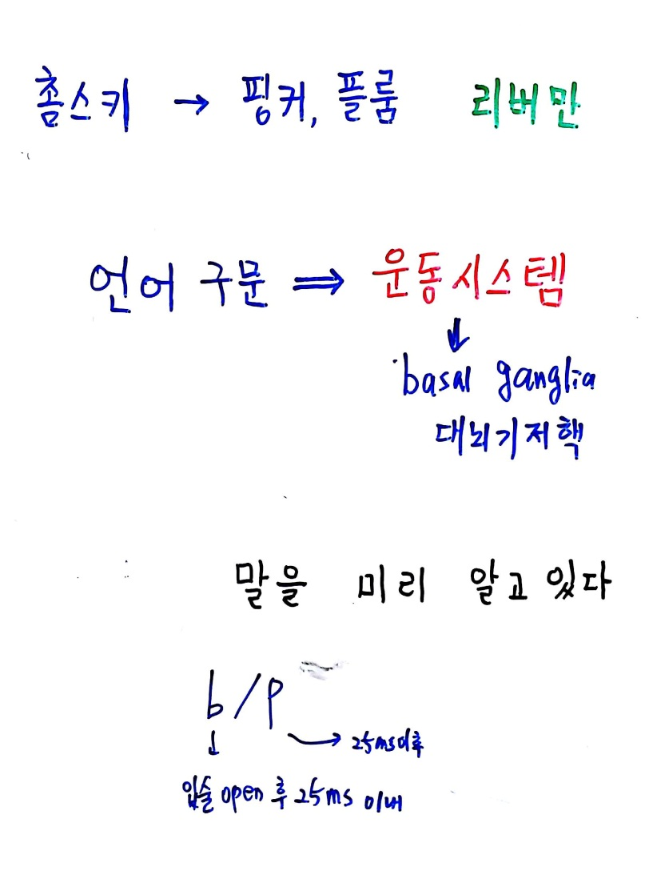

Slide 5
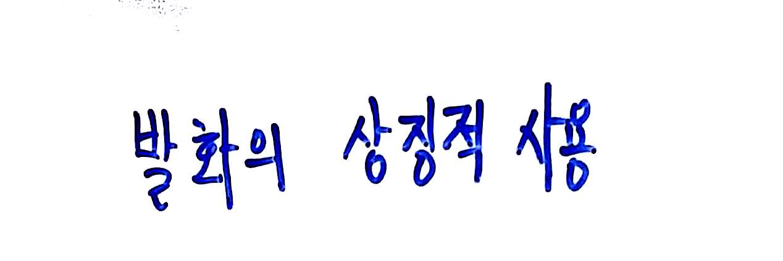

Slide 6
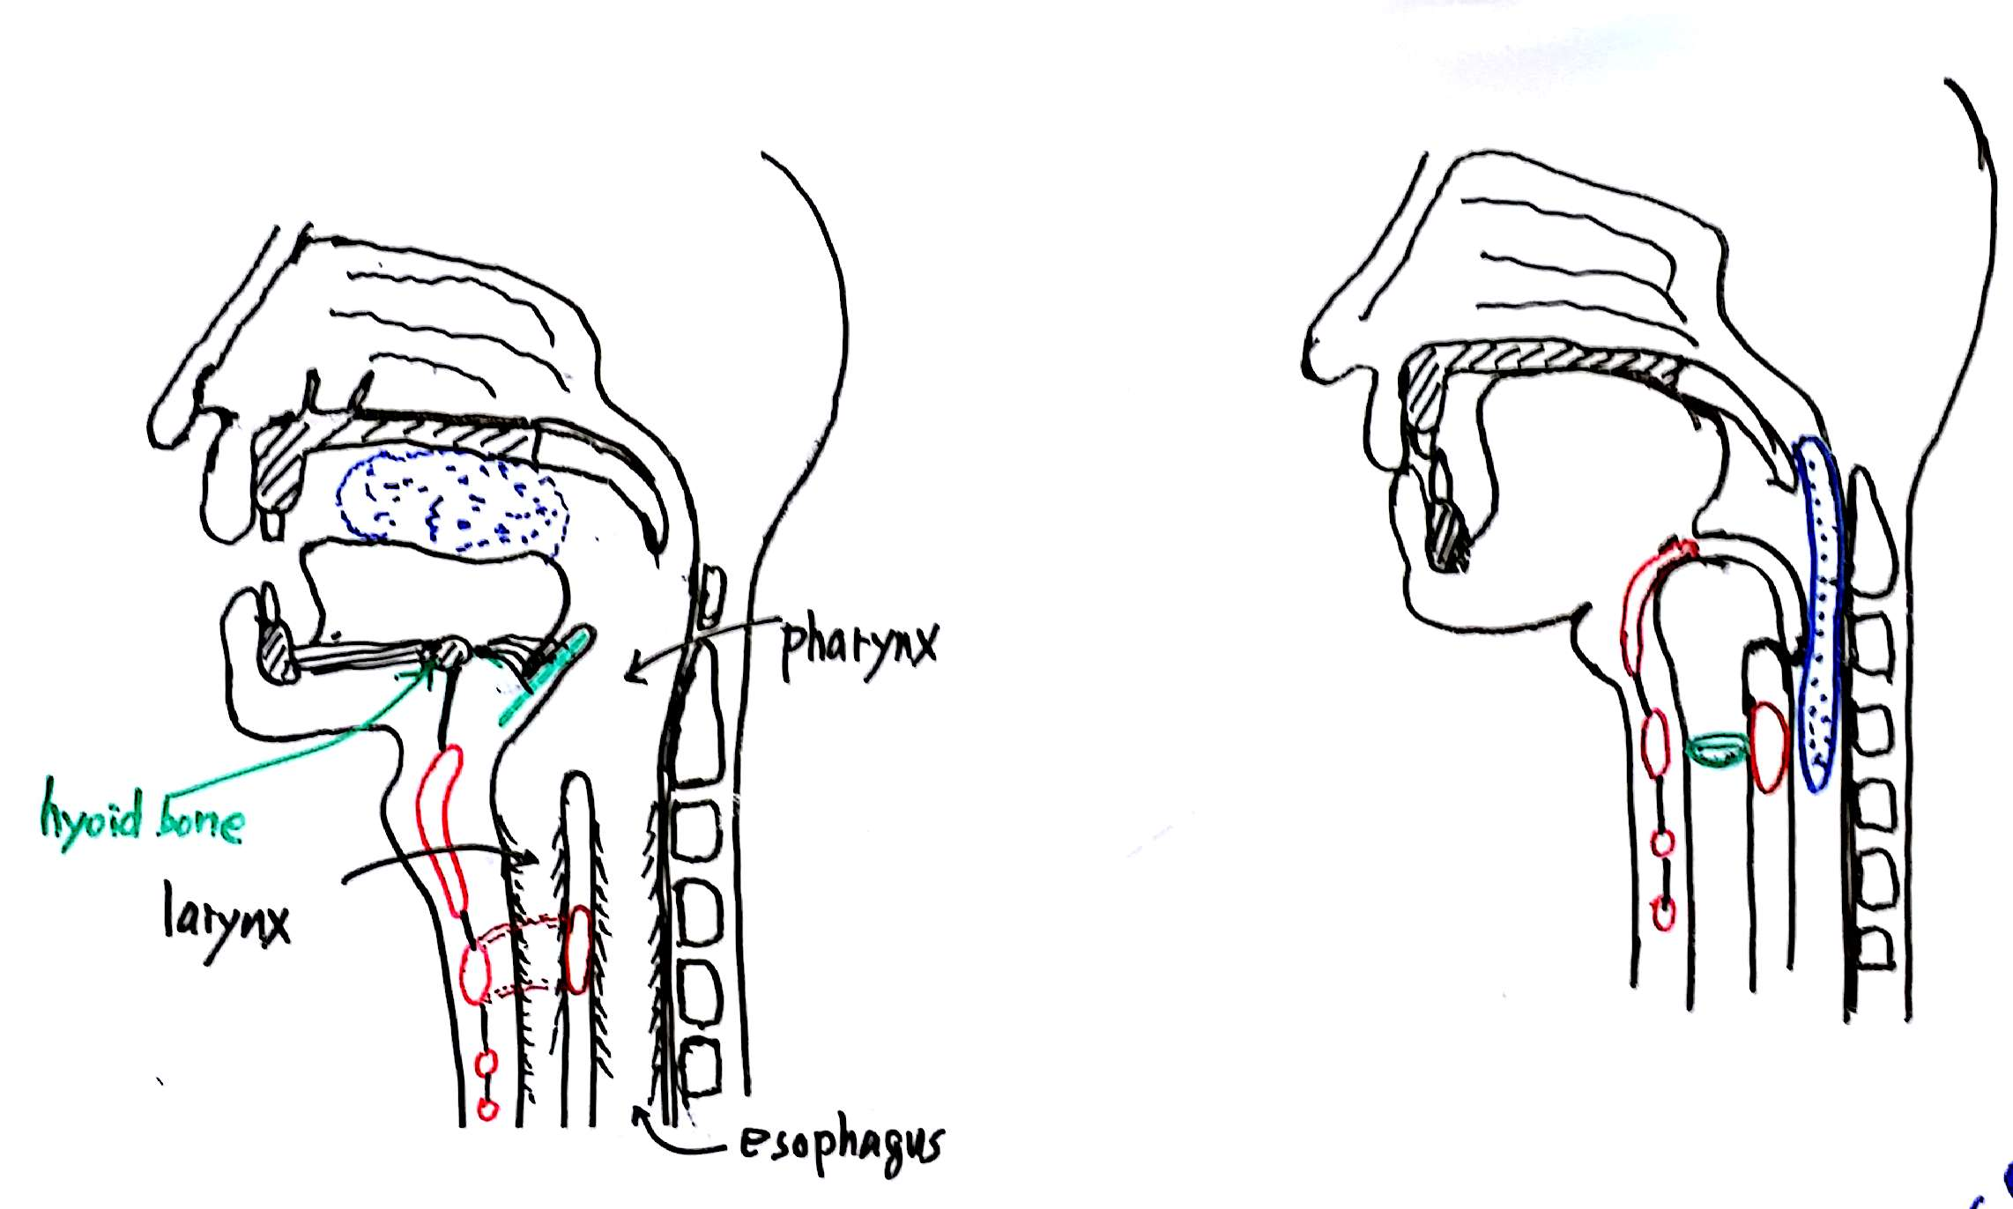

Slide 7
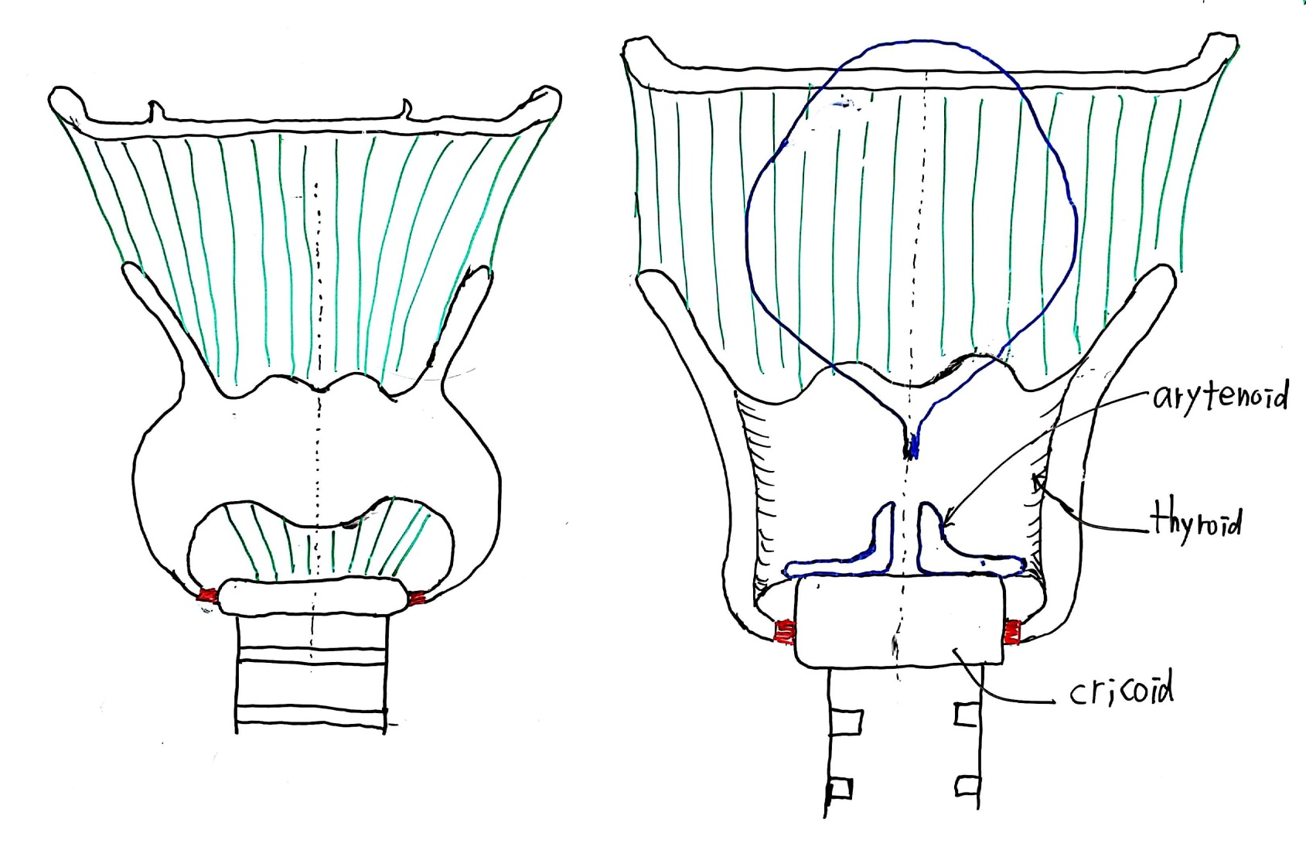

Slide 8
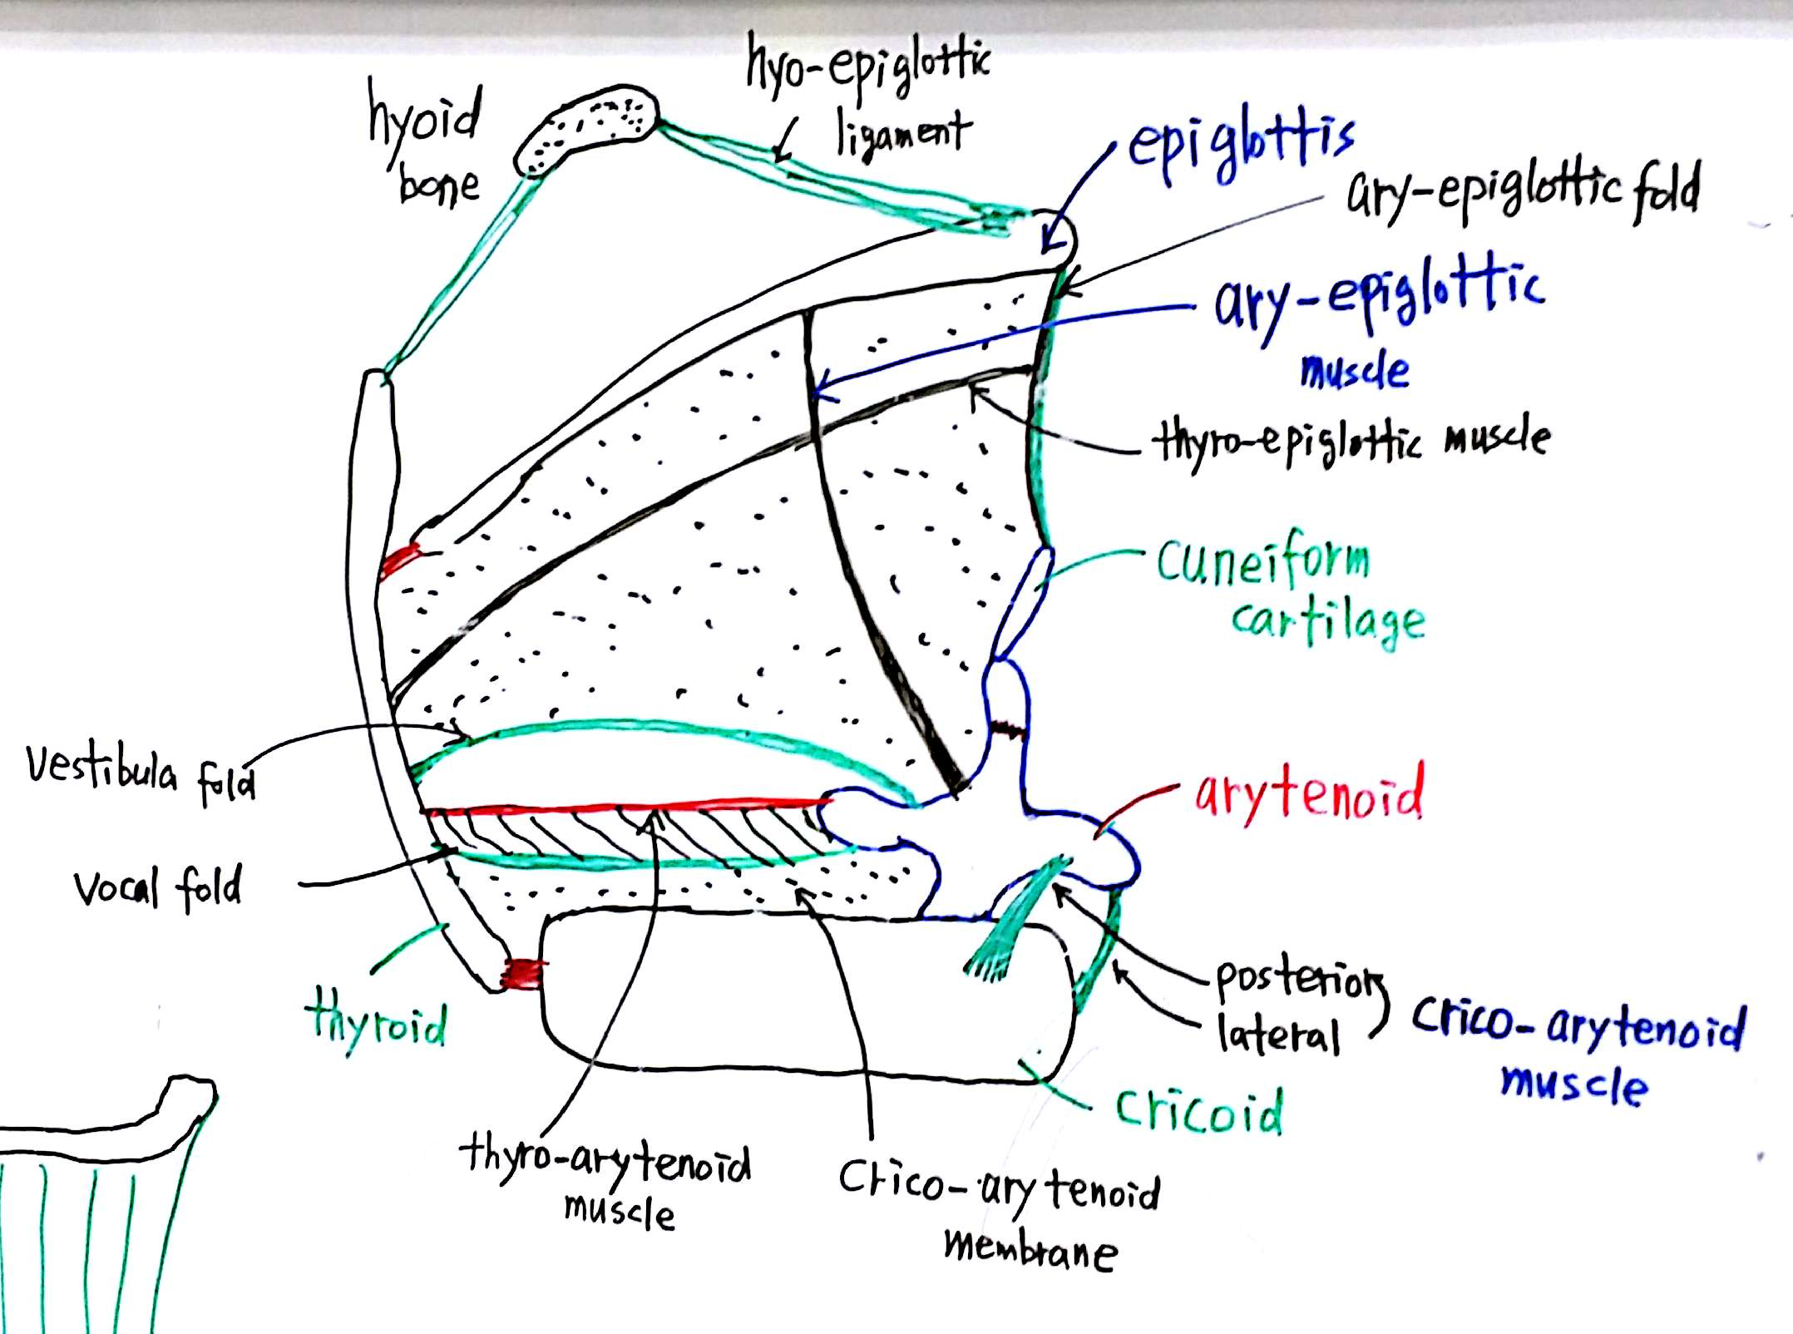

Slide 9
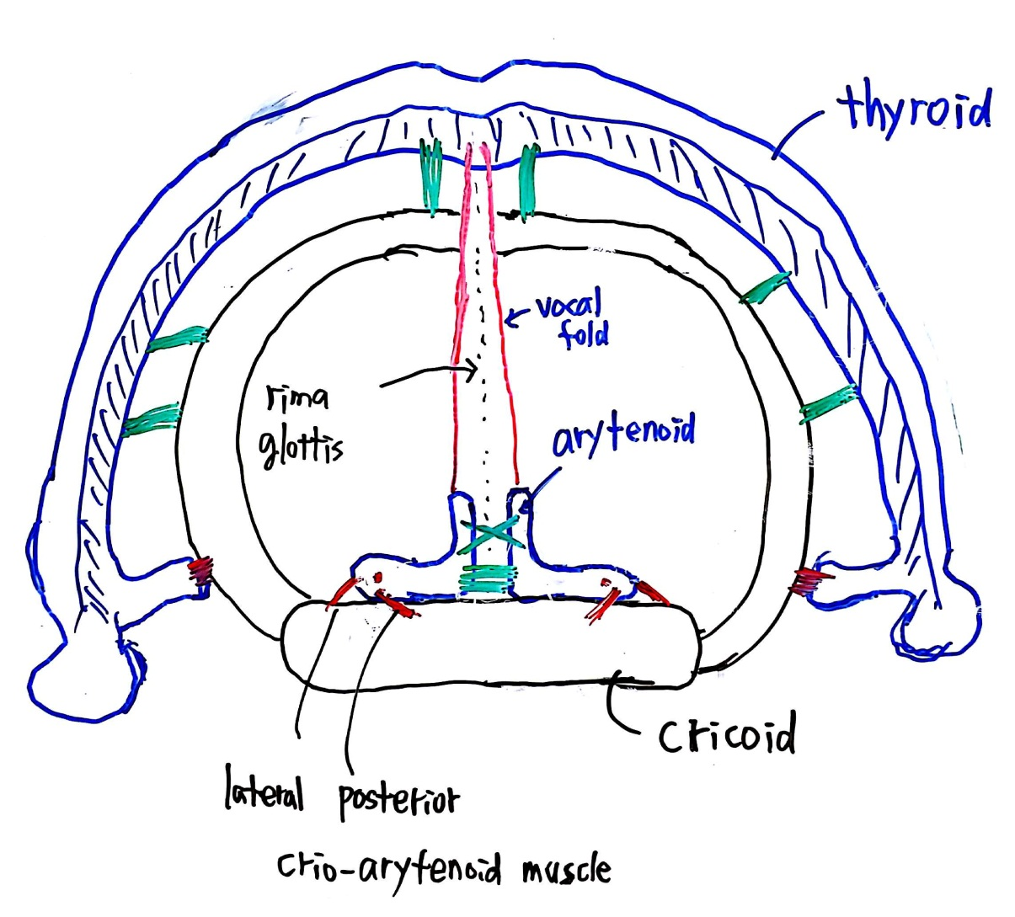

Slide 10
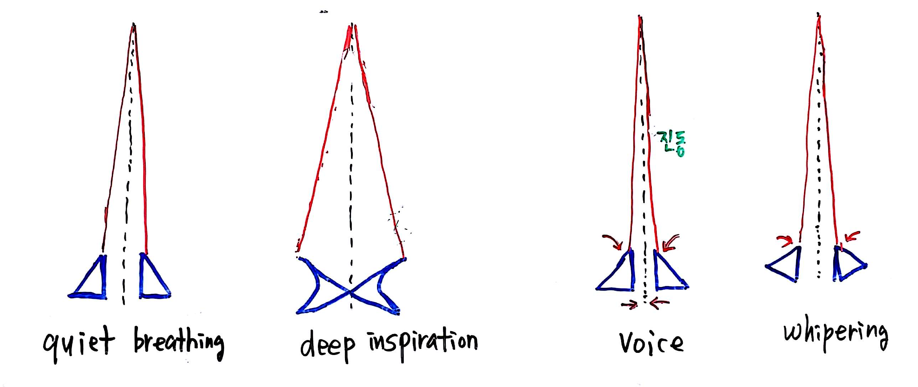

Slide 11
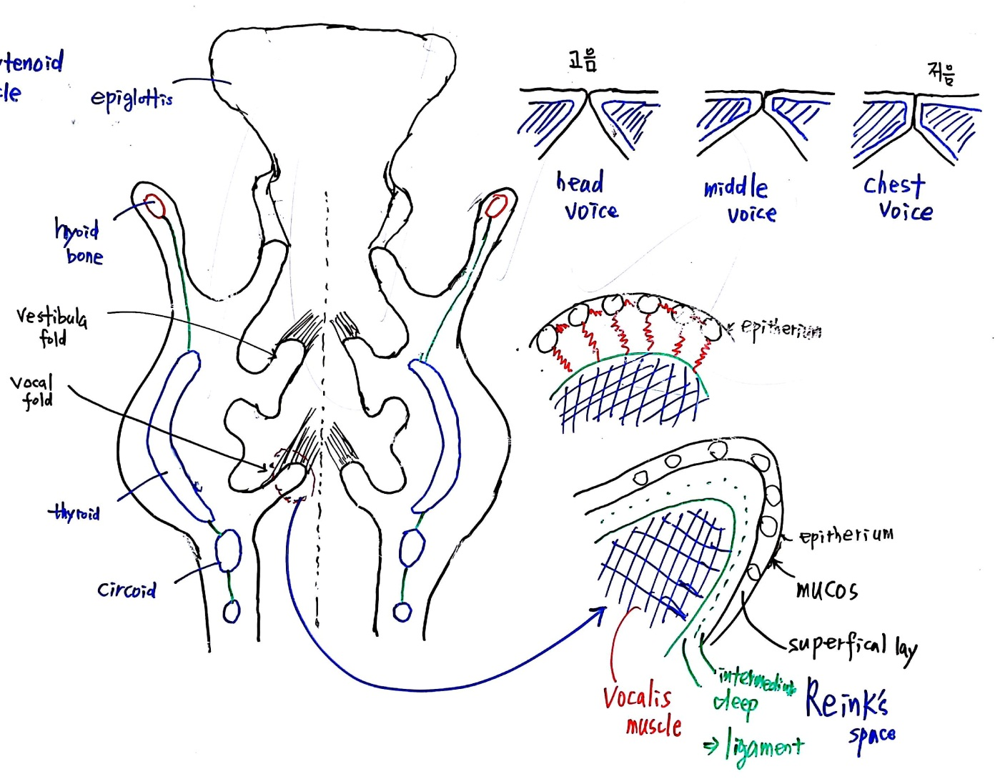

Slide 12
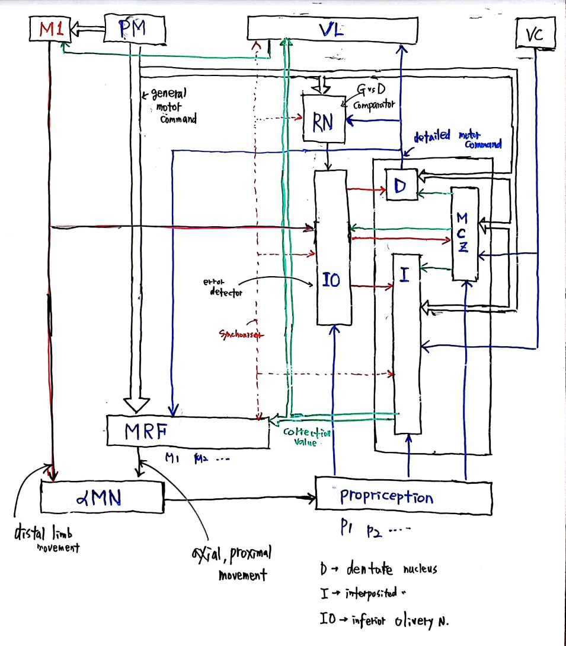
* PM - Premotor area
* VL - Ventro-lateral
* IO – Inferior Olivary N
* D - dentate N
* I – Interpositus N
(globose N + emboliform N)
* MRF - mesencephalic reticular formation
* MCZ – Motor Cortex Zone

Slide 13
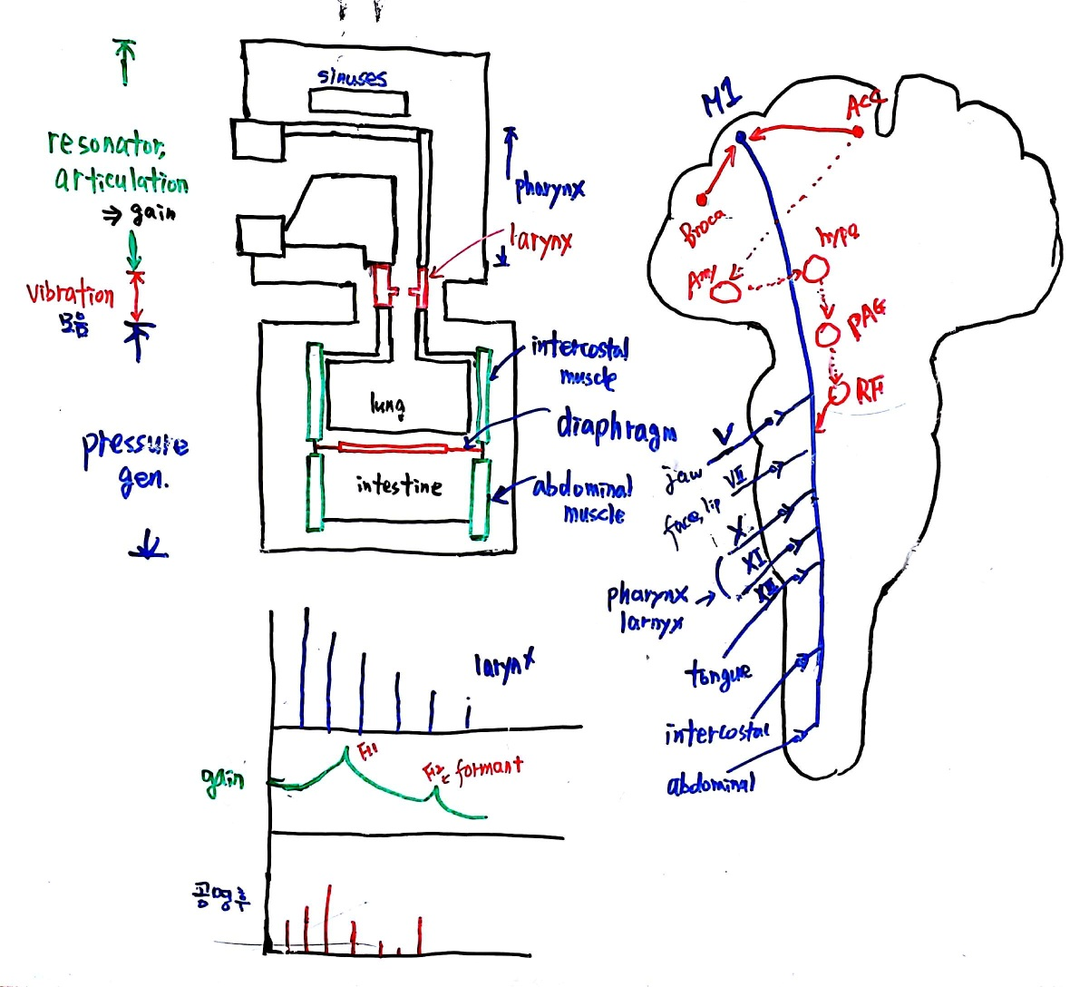
pre

