Slide 1
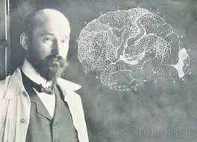
20170205
제19차
과학리딩
Broad’s map &
Thalamus

Slide 2
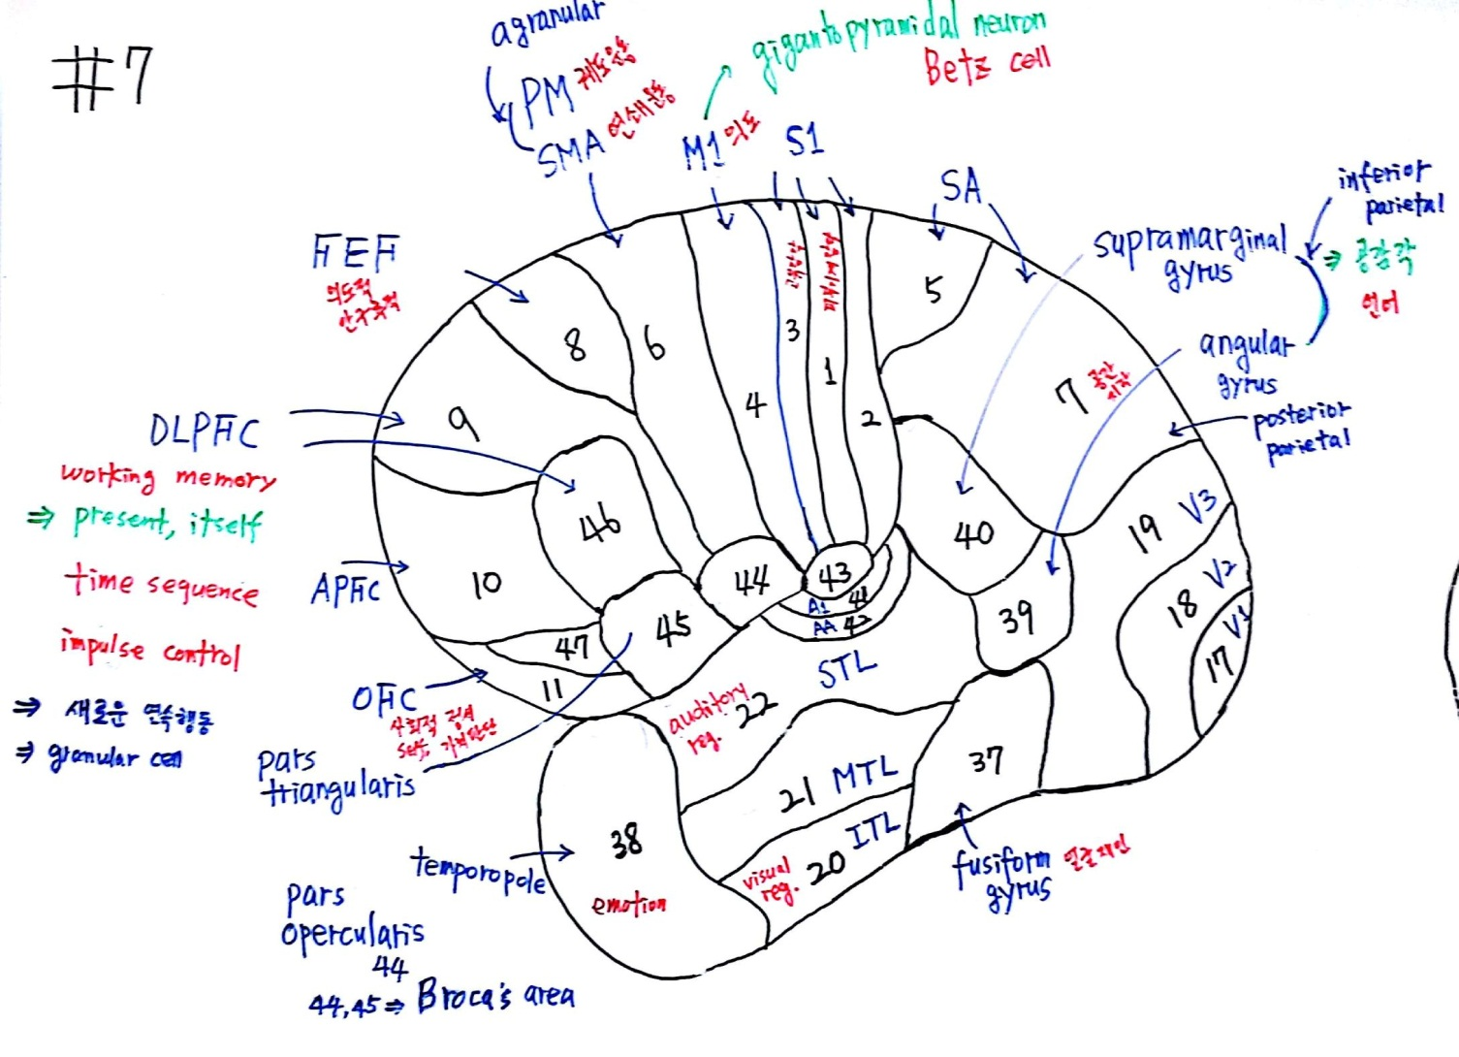
Frame 7’1 – Broad’s map1

Slide 3
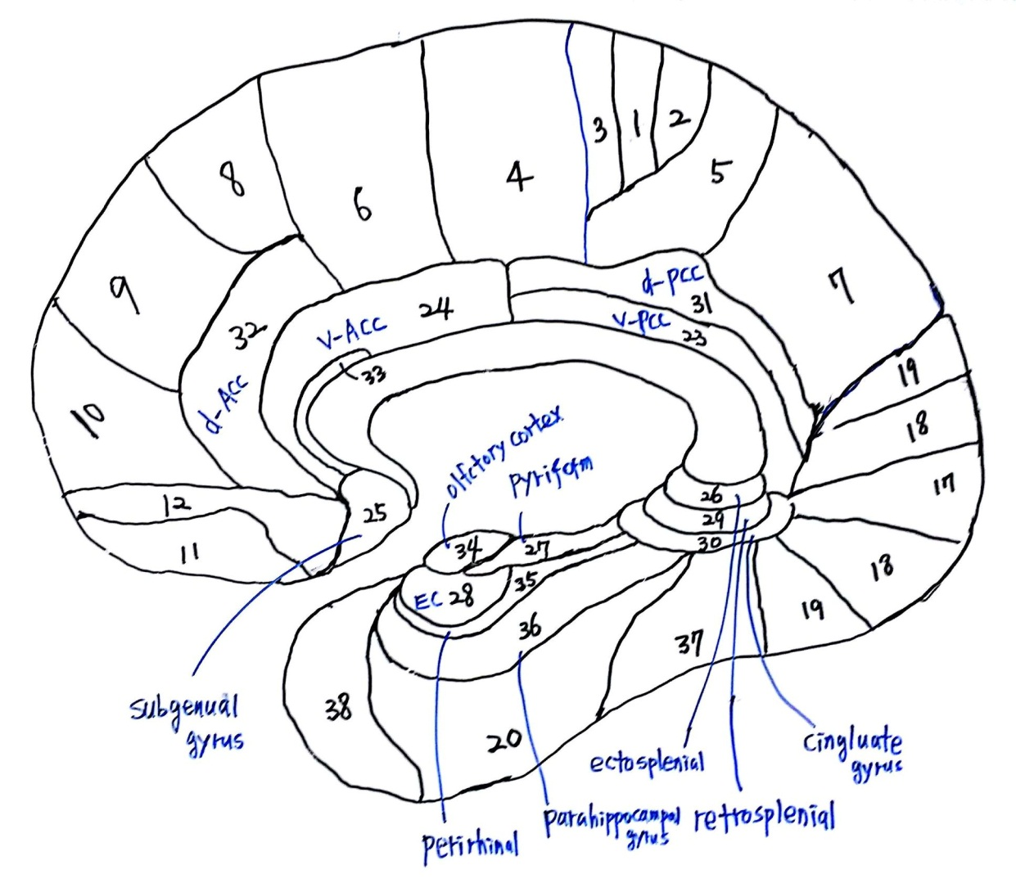
Frame 7’2 – Broad’s map2

Slide 4
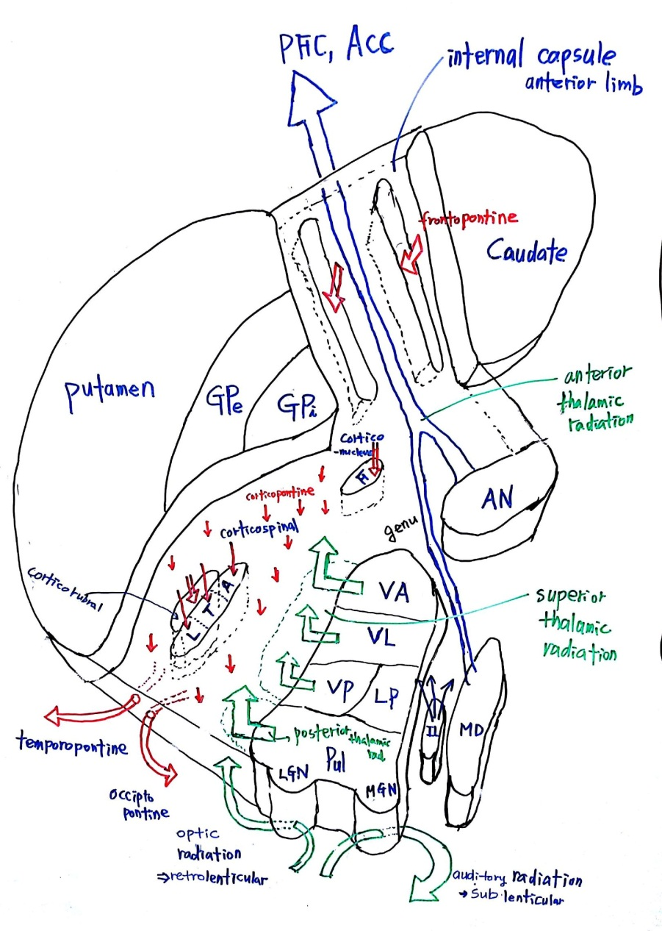
Frame 8’1 – Thalamus(internal capsule)

Slide 5
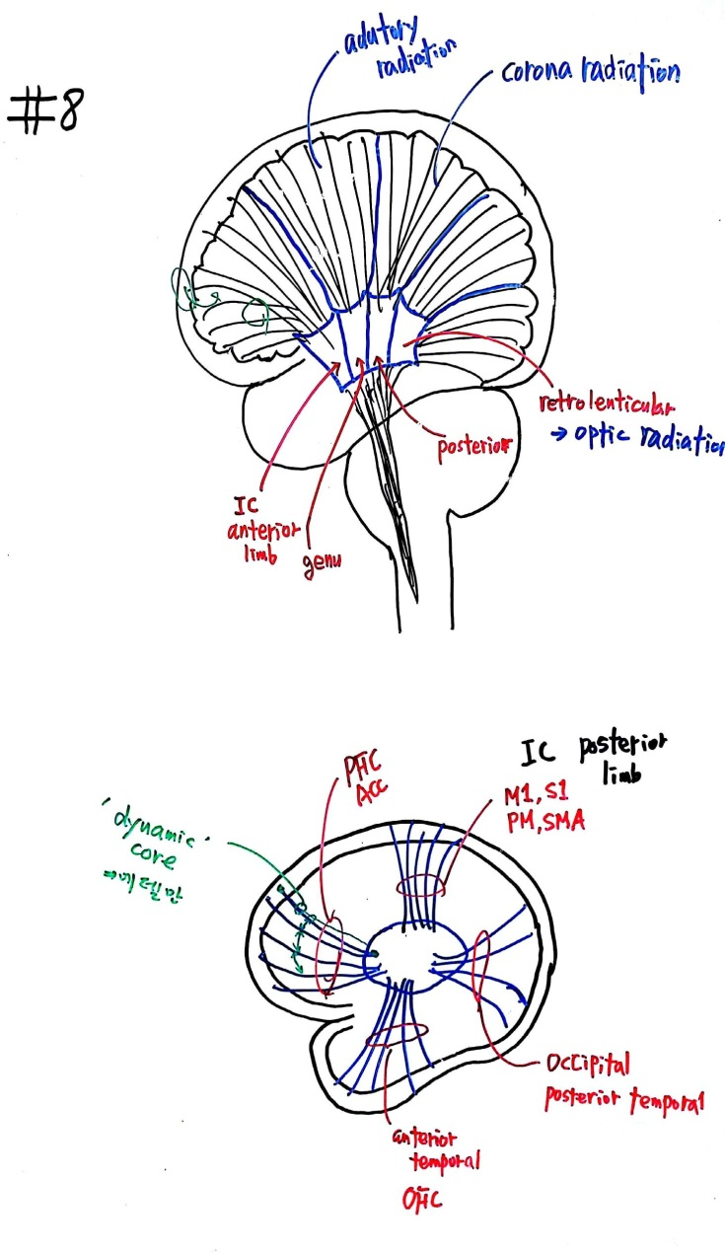
Frame 8’2 – Thalamus-Cerebral cortex

Slide 6
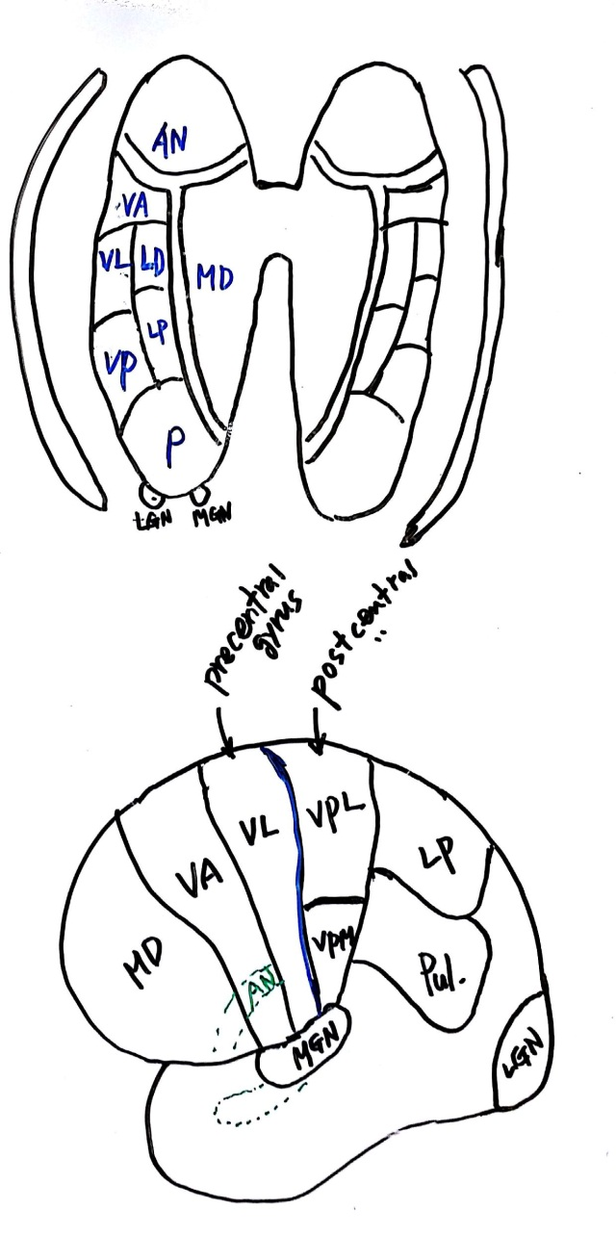
Frame 8’3 – Thalamus-Cerebral cortex

Slide 7
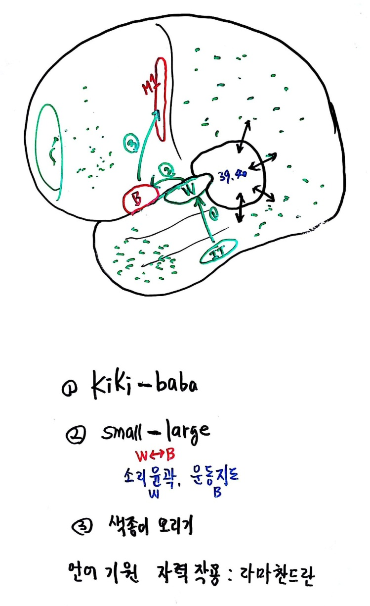
Frame 7 보조 – 언어 Pathway

